Slide 1
Covenant
Lesson 8

Slide 2
Abrahamic Covenant
Gen. 12:1-9 The Lord promised Abram at 75 years of age, that He would
1. Make him a great nation
2. Bless him
3. Make his name great
4. All the families of the earth would be blessed
Gen. 13:14-18 Lot and Abram separated, and the Lord promised Abram a land, and descendants as numerous as the dust of the earth
“Dust”: uncountable abundance
Gen. 2:7 The Lord God formed man from the dust of the earth
Gen. 3:19 “For you are dust, and to dust you shall return”

Slide 3
Abrahamic Covenant
Gen. 15:5-21 God promises Abram descendants as numerous as the stars
“Stars”: Immeasurability. Certainty. Stars are fixed, visible reminders that God’s oath cannot fail. Captains even use them to navigate…..
God tells Abram his descendants will be slaves for 400 years, but they would come out and He would judge the nation that enslaved them.
Gen. 17 Abram is 99 years old and God changes his name to Abraham
The sign of the covenant is also given which is circumcision
Gen. 25:23, 33-34 Esau and Jacob represent 2 nations in Rebekah’s womb
The older would serve the younger. Esau sells his birthright to Jacob

Slide 4
Abrahamic Covenant
Gen. 26:1-6, 24-25 The Lord confirms His covenant to Isaac
Gen. 28:10-22 The Lord confirms His covenant to Jacob/Israel
Jacob knows for certain that the Seed will come from HIM and not from his older brother, Esau. Jacob is promised the land, descendants and the blessing
Gen. 32:24-30 God changes Jacob’s name to Israel after wrestling with him
Gen. 49:1-28 The 12 tribes of Israel are listed and their journey to Egypt
Gen. 15:13 is about to be fulfilled as they are now in Egypt
Ex. 1:8-14 While they are in Egypt, Israel becomes “mighty”
The Egyptians fear them because they are so mighty, so they oppress them

Slide 5
Israel’s prayer to God
Ex. 2:23-25 Israel sighed and cried out because of their bondage
“Sighed” gives voice to a heart overwhelmed by circumstances larger than itself yet still sensitive to the presence and purposes of God. It is a spontaneous, involuntary exhalation making weight of oppression.
God’s response to their “sigh”?
“Heard” – attentive consideration and responsive obedience
“Remembered” – bringing to active awareness and intentional action
“Saw and Took notice” – to ascertain BY seeing
God “obeyed” because He was in covenant with Israel and the 400 years had been completed

Slide 6
Old Covenant
Ex. 19:1-9 The Lord brought Israel OUT of Egypt and INTO the wilderness of Sinai
IF – the people would…..
THEN – God would………
The people said, “All that the Lord has said we will do”
Ex. 23:32-33 The people were to drive out those living in the land because:
“they will make you sin against Me”.
They were to make NO covenant with them
Ex. 24:1-18 Moses receives the 10 commandments on the mountain

Slide 7
The Tabernacle
Ex. 25:1-9 Moses tells the people to take up a contribution and build a sanctuary for Him so that He could dwell with them
Where did their contributions come from?
Ex. 12:36 The Lord had given the people favor in the sight of the Egyptians so that they let them have their request. Thus, they plundered the Egyptians.
Slaves don’t come out of the land of their bondage with plunder!!!
Moses was to construct the Tabernacle “according to the pattern” God gave him on the mountain.
This pattern was according to the REAL Tabernacle in heaven Heb. 8:4-5
Moses was the mediator of the Old Covenant.

Slide 8
The Tabernacle as a picture of Jesus
Enter through the gate: Matt. 7:13 Enter through the narrow gate
Bronze altar where the animal sacrifices were unwillingly tied: Jesus is our sacrifice I Cor. 5:7 He willingly laid His life down John 10:18
Bronze laver where the priests washed: believers are cleansed by the washing of the water of the Word. John 1:1. Eph. 5:26
The door to the tent of meeting where the priest entered. Jesus is the door and no one comes to the Father but through Him. John 14:6
Table of Showbread: Jesus is the bread of life John 6:35
The Lampstand: Jesus is the light of the world John 8:12
Altar of incense: Jesus is the intercessor for the saints Heb. 7:25

Slide 9
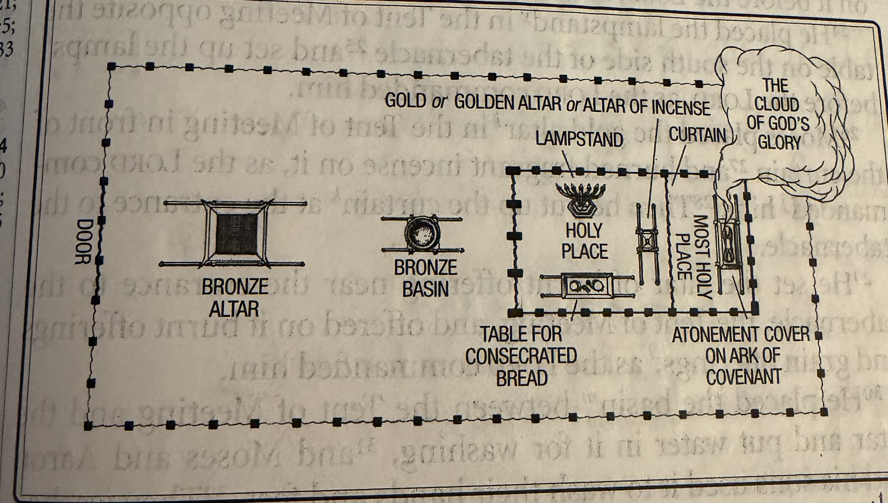
Diagram of Tabernacle

Slide 10
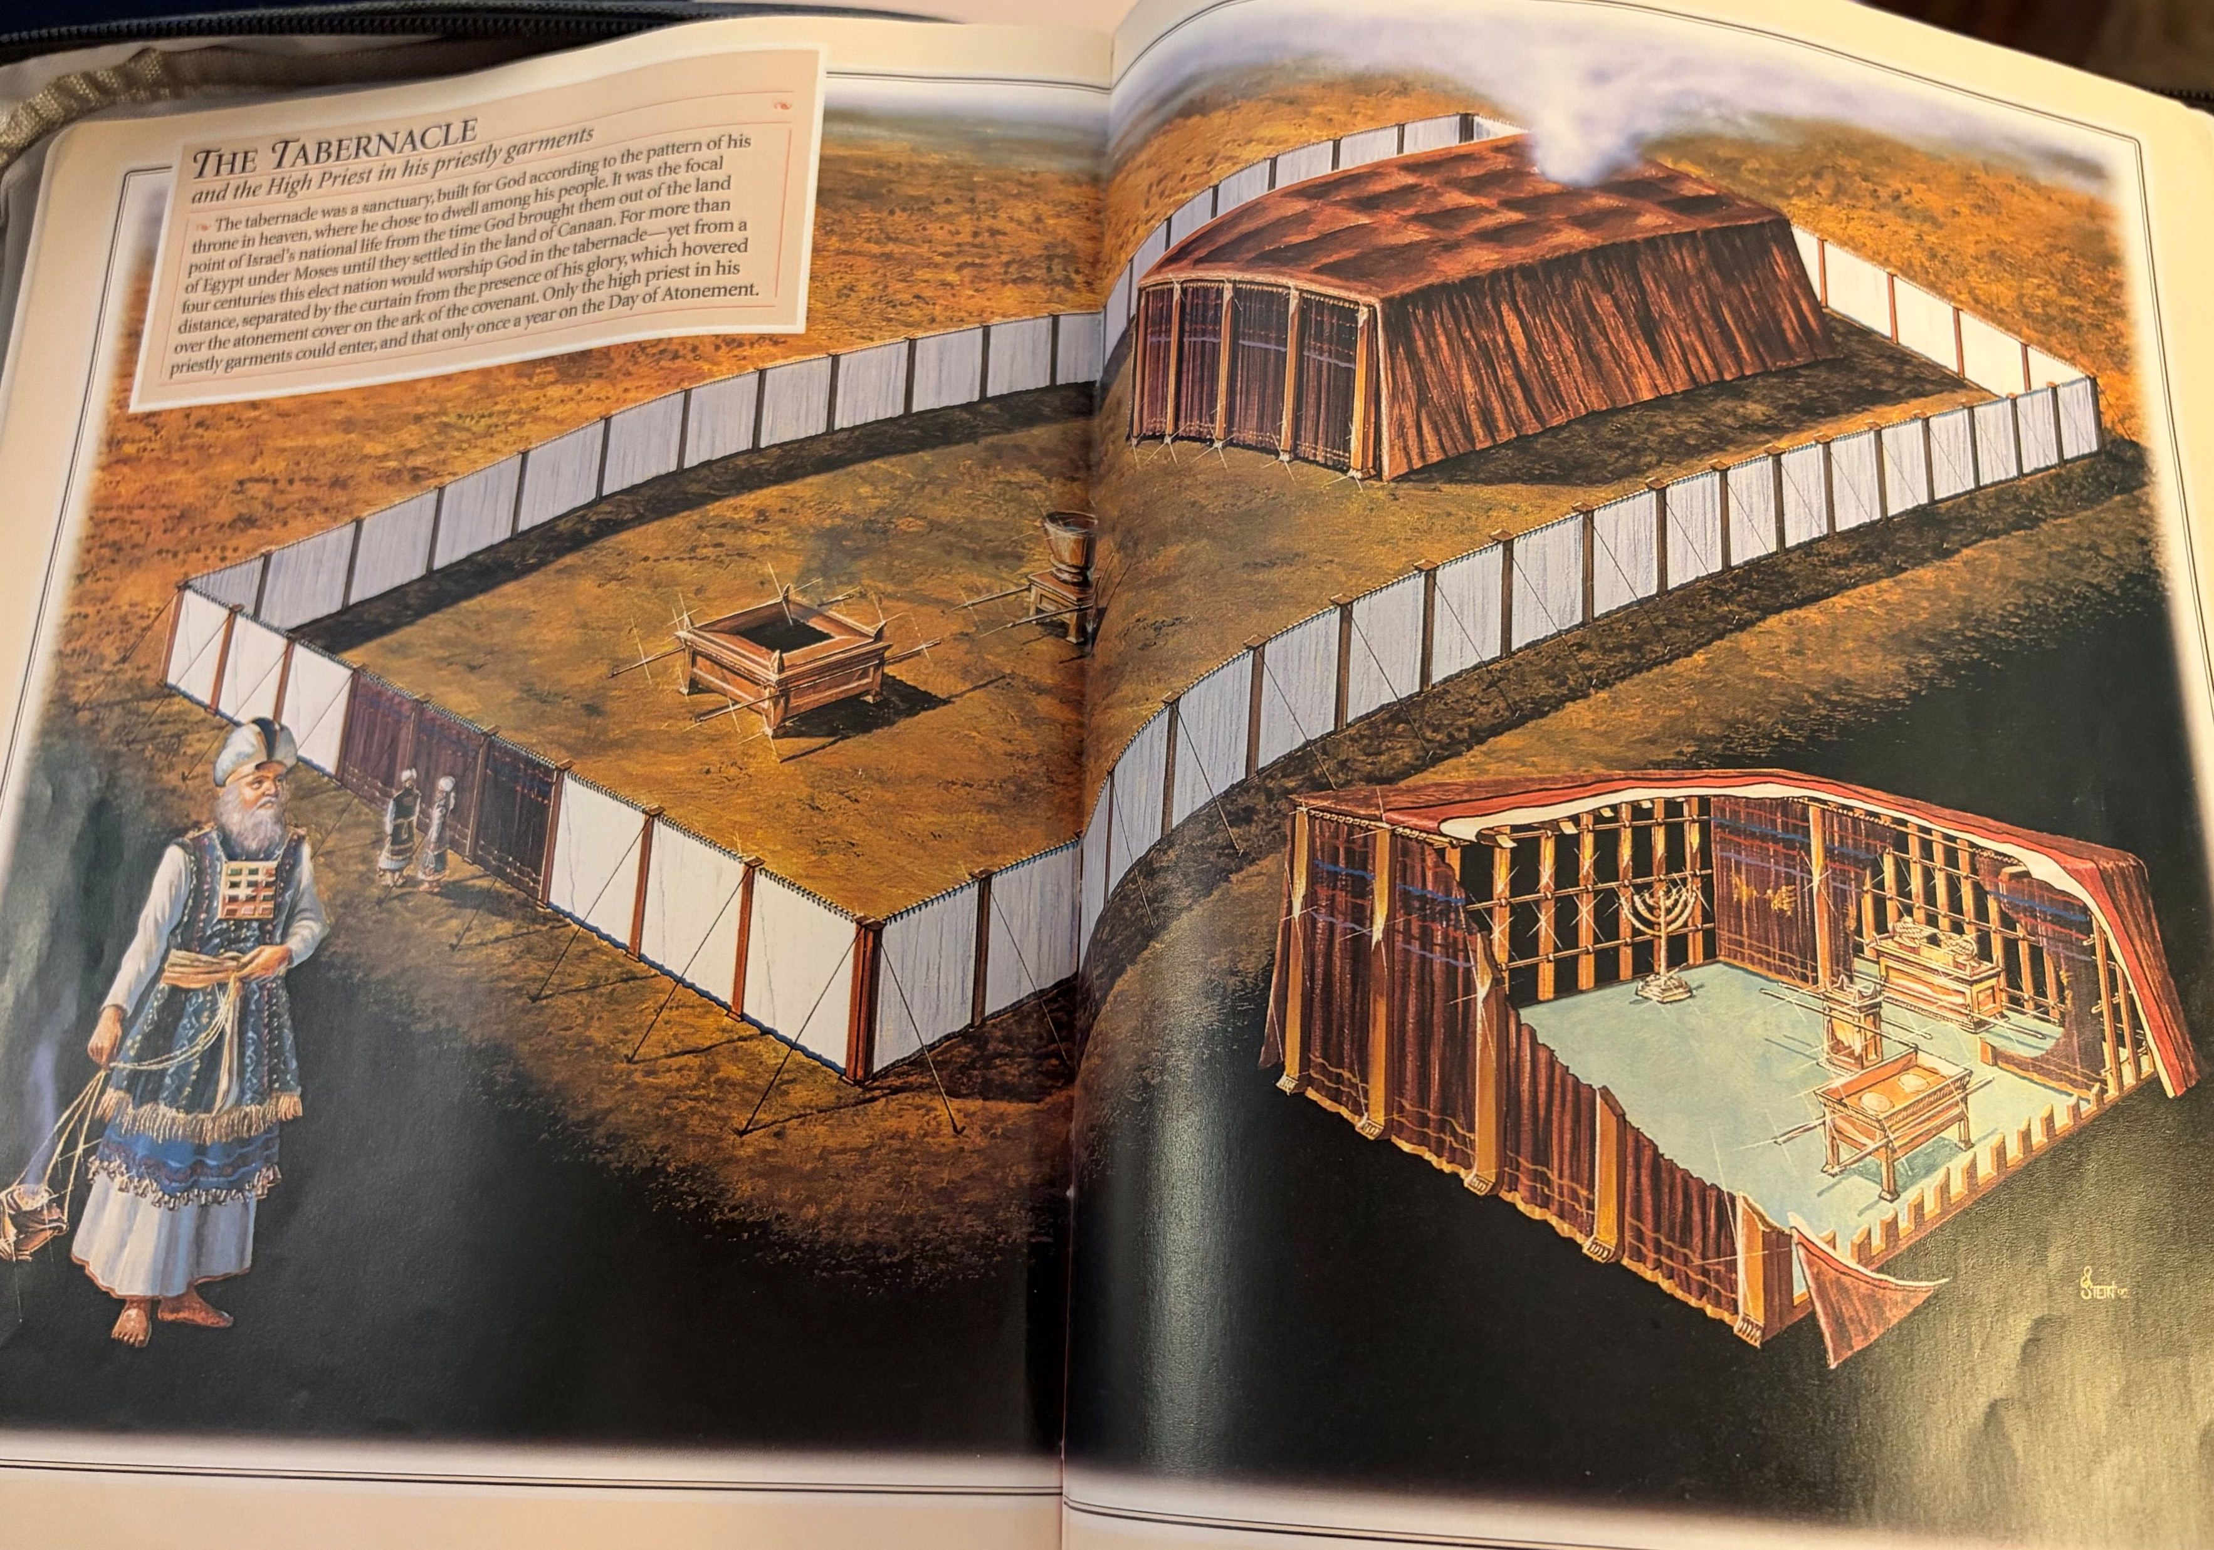
Tabernacle

Slide 11
Jesus the Veil
The veil: separated the holy place from the holy of holies
NO ONE but the High Priest could enter behind that veil except once a year
Only AFTER he had made atonement for his own sins
Only him. No One else. NO ONE had access to the presence of God but him and only once a year
That very veil was torn in two when Jesus died on the cross, making atonement for the sins of the whole world.
Now EVERYONE has access to the Father, to the presence of God by coming through Jesus’ flesh, Jesus’ blood, Jesus’ sacrifice ONCE for all. Heb. 9
Mercy covers ME!!!

