Slide 1
Romans Part 4
Lesson 7

Slide 2
Romans 14:1-12 Principle of Liberty
Accept the one weak in faith, NOT for the purpose of judging him, but for the purpose of unity
Who are you? Are you the servant or the Master? God is the Master whom we both serve.
Who is able to make the servant stand and not fall (sin)? It isn’t the Law. It isn’t YOU! Only the Master, the Lord Jesus Christ has that ability.
Where will we all, as believers, eventually stand to be judged?
The Judgment Seat of God.
Therefore, since that certain accountability awaits us…….

Slide 3
Romans 14:13-23 Principle of Love
Edify One Another (Wiersbe) Christians affect each other
We can either: judge, love, “set a trap” so they stumble, or destroy our brother. “Knowledge plus love helps the weak brother grow strong.”
Rom.14:14“What something does to a person determines its quality.” Wiersbe If he thinks it is unclean, IT IS! Can’t watch this, can’t read this….
“Walk according to love”: to present a dynamic, continuous pattern of conduct that flows from one’s relationship with God.
Pursue peace and building up, not destroying, tearing down, God’s work.
“Conscience is strengthened by knowledge.” Wiersbe
So, use your knowledge with love, not judgment.

Slide 4
Romans 15:1-6
Possible Theme: Accept one another as Christ accepted us both
Rom. 11:18 Remember the “root” supports, endures, bears YOU up.
Christ did not please Himself
The Scriptures and God Himself are the source of perseverance and encouragement, which requires “knowledge” of both.
Purpose: unity. One mind, One another, One accord, One voice.
“Harmonized hearts erupt in harmonized praise, fulfilling the purpose of redemption.” Bible Hub
How does this glorify God?

Slide 5
Romans 15:7-13
Christ welcomed both Jew and Gentile
Christ served the Jews by confirming the promise given to the fathers
Christ served the Gentiles by extending mercy to them as well, fulfilling the Old Testament prophecies: Ps. 18:49; 117:1; Deut. 32:43; Is. 11:1, 10
Rom. 15:13 is Paul’s prayer, reminding them what the kingdom of God is actually made of: joy and peace and righteousness and is only through the Holy Spirit’s power
“Our success in the Christian life does NOT depend on the opinions or attitudes of other Christians, but on Christ alone.” Wiersbe

Slide 6
Ephesians 2:11-22
Gentiles were formerly separated from God’s people, the Jews/Israel
Strangers to the Covenant of Promise, without God in the world
But now: Christ’s blood brought the Gentiles near
Christ, the Prince of Peace, made peace between Jew and Gentile, abolishing in His flesh, the enmity between the two, making us into one
Both groups needed peace! Kingdom of God is peace, joy, righteousness
Both needed access to the Father
Both then, now united, are growing as a body, a temple of the Holy Spirit

Slide 7
Romans 15:14-18 Paul
Paul is an encourager and is known for his bold writing
Encouragement: They are full of goodness and all knowledge, capable of admonishing/instructing one another. Both weak and strong brothers
Boldness in his ministry: he had experienced the grace of God, he was called as a priest of the gospel to the Gentiles for the purpose of presenting them as an offering, acceptable to God, which resulted in their obedience of faith.
Without Paul’s obedience of faith, would we Gentiles have been given the gospel of Christ?

Slide 8
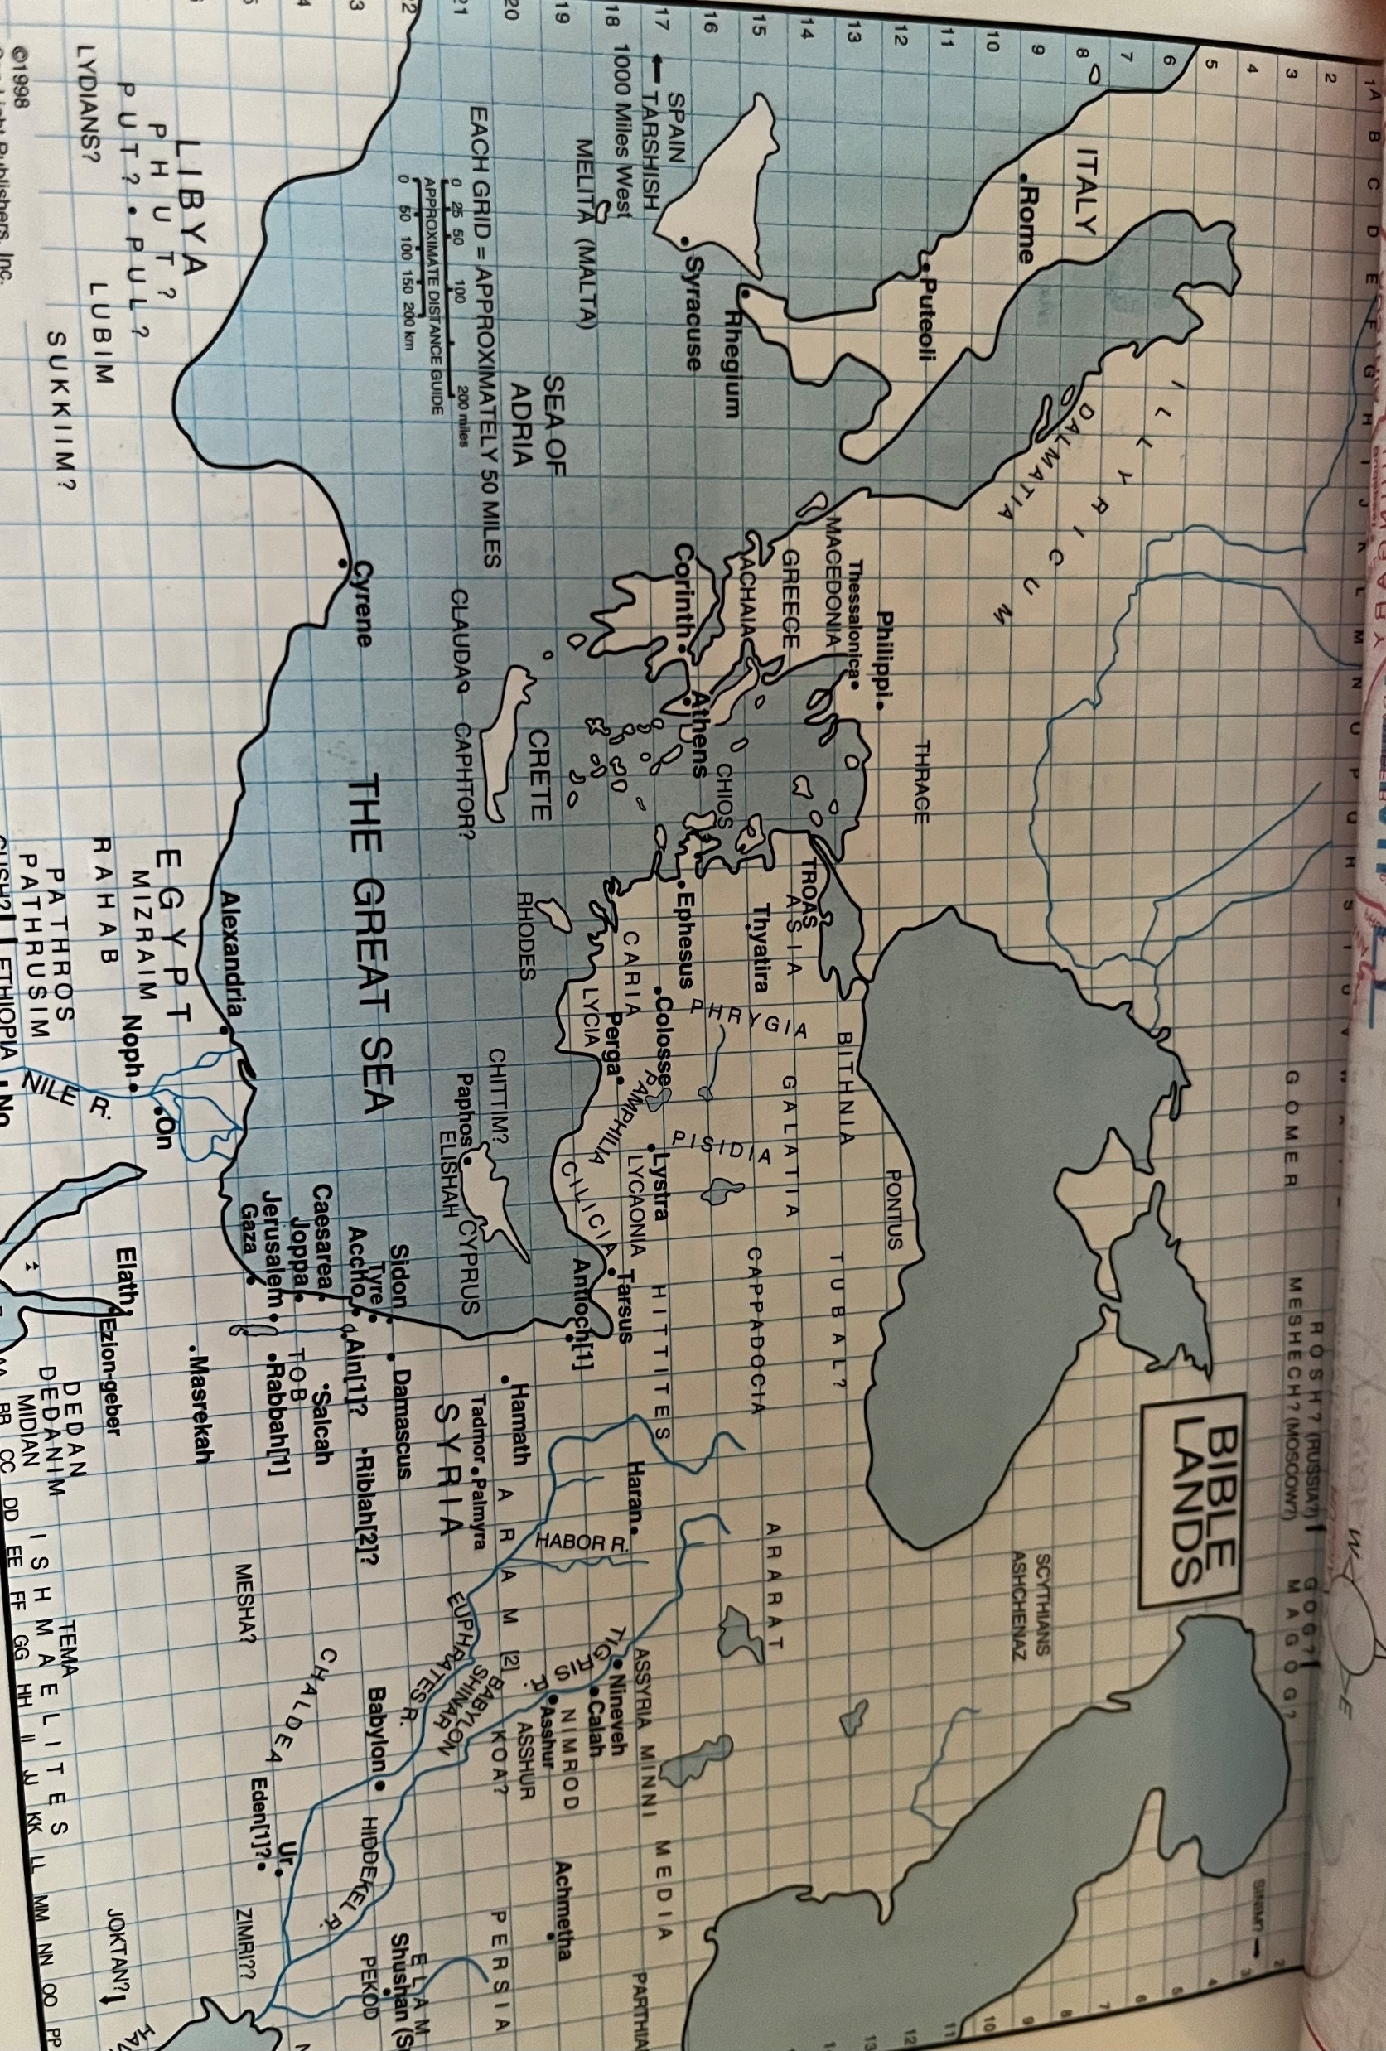



Map of Illyricum to Jerusalem

Slide 9
Romans 15:19-29
Paul had preached the gospel from Jerusalem to Illyricum: 1,400 miles
He had preached it with the power and wonders of the Holy Spirit
He did not want to build on someone else’s foundation
He was on his way to Jerusalem to bring a contribution to the poor there from the believers in Achai and Macedonia
These Gentile believers, were giving to their Jewish brothers in Jerusalem, out of deep poverty and affliction.
This material gift was intended to bring unity, showing their gratitude for the Jew’s spiritual gift of Jesus the Messiah.

Slide 10
Romans 15:30-33
Paul’s prayer request:
He wanted to be rescued from the disobedient/unbelievers in Judea
Jews in Jerusalem might take offense to him ministering to Gentiles
He wanted his service for Jerusalem to be acceptable to the saints there
He wants to see the believers in Rome, to come with joy and find rest in their company
“Now the God of peace be with you all. Amen.” The kingdom of God is peace and joy and righteousness.

Slide 11
Application
Some quotes from Wiersbe:
“We must focus on the “eternals” and not the “externals”.
“A persons’ spiritual maturity is revealed by his discernment.”
“Disunity and disagreement do not glorify God; they rob Him of glory.”
“Because the Jewish Christians were faithful to take the Gospel to the Gentiles, the nations of the world today have the opportunity to trust Christ as Savior.”
Antisemitism has NO place in the Christian’s life: NONE!!!

