Slide 1
Romans Part 2
Lesson 8

Slide 2
Review
Romans 6 Believers, the righteous, died to sin. They are freed from slavery to sin and become slaves to God and righteousness. Sanctification
Theme: Dead to Sin; Alive to God
Romans 7 The righteous, or believers, are dead to the Law. They are freed from the Law and serve God in newness of Spirit.
Theme: The Law and the Believer’s relationship to it
Romans 8 Believers are set free by the Spirit of life in Christ Jesus.
The Spirit of God, of Christ Jesus, indwells all of His children, therefore, the requirements of the Law are fulfilled.
Theme: Spirit of life in Christ Jesus has set me free from law of sin and death

Slide 3
Romans 8
Those in Adam:
Walk/live according to the flesh and set their minds on the things of the flesh which brings death
Hostile toward God
Not subject to God’s law, not even able to subject themselves to it
Cannot please God
Must die
They are still under the dominion of the flesh, sin and death

Slide 4
Romans 8
Those in Christ:
No condemnation
Set free from law of sin and death by the Spirit
Fulfill the Law’s requirement because the Spirit indwells them
Live according to the Spirit
Righteous
They put to death the deeds of the body by being led by the Spirit of God
Called sons of God, heirs and adopted
Will suffer with Christ and be glorified

Slide 5
Interpretation Questions
Can those in Christ have a lifestyle of sin?
Can those in Christ be in bondage to sin?
Can those in Christ endure suffering?
What is Paul’s purpose in this chapter?
Why do people not address their spiritual life; not seem concerned about it or where they will spend eternity?
Can people “try” Jesus and walk away? Do I have people in my life like that?
What kind of faith is that? Saving? Fire insurance? Obedience of faith?

Slide 6
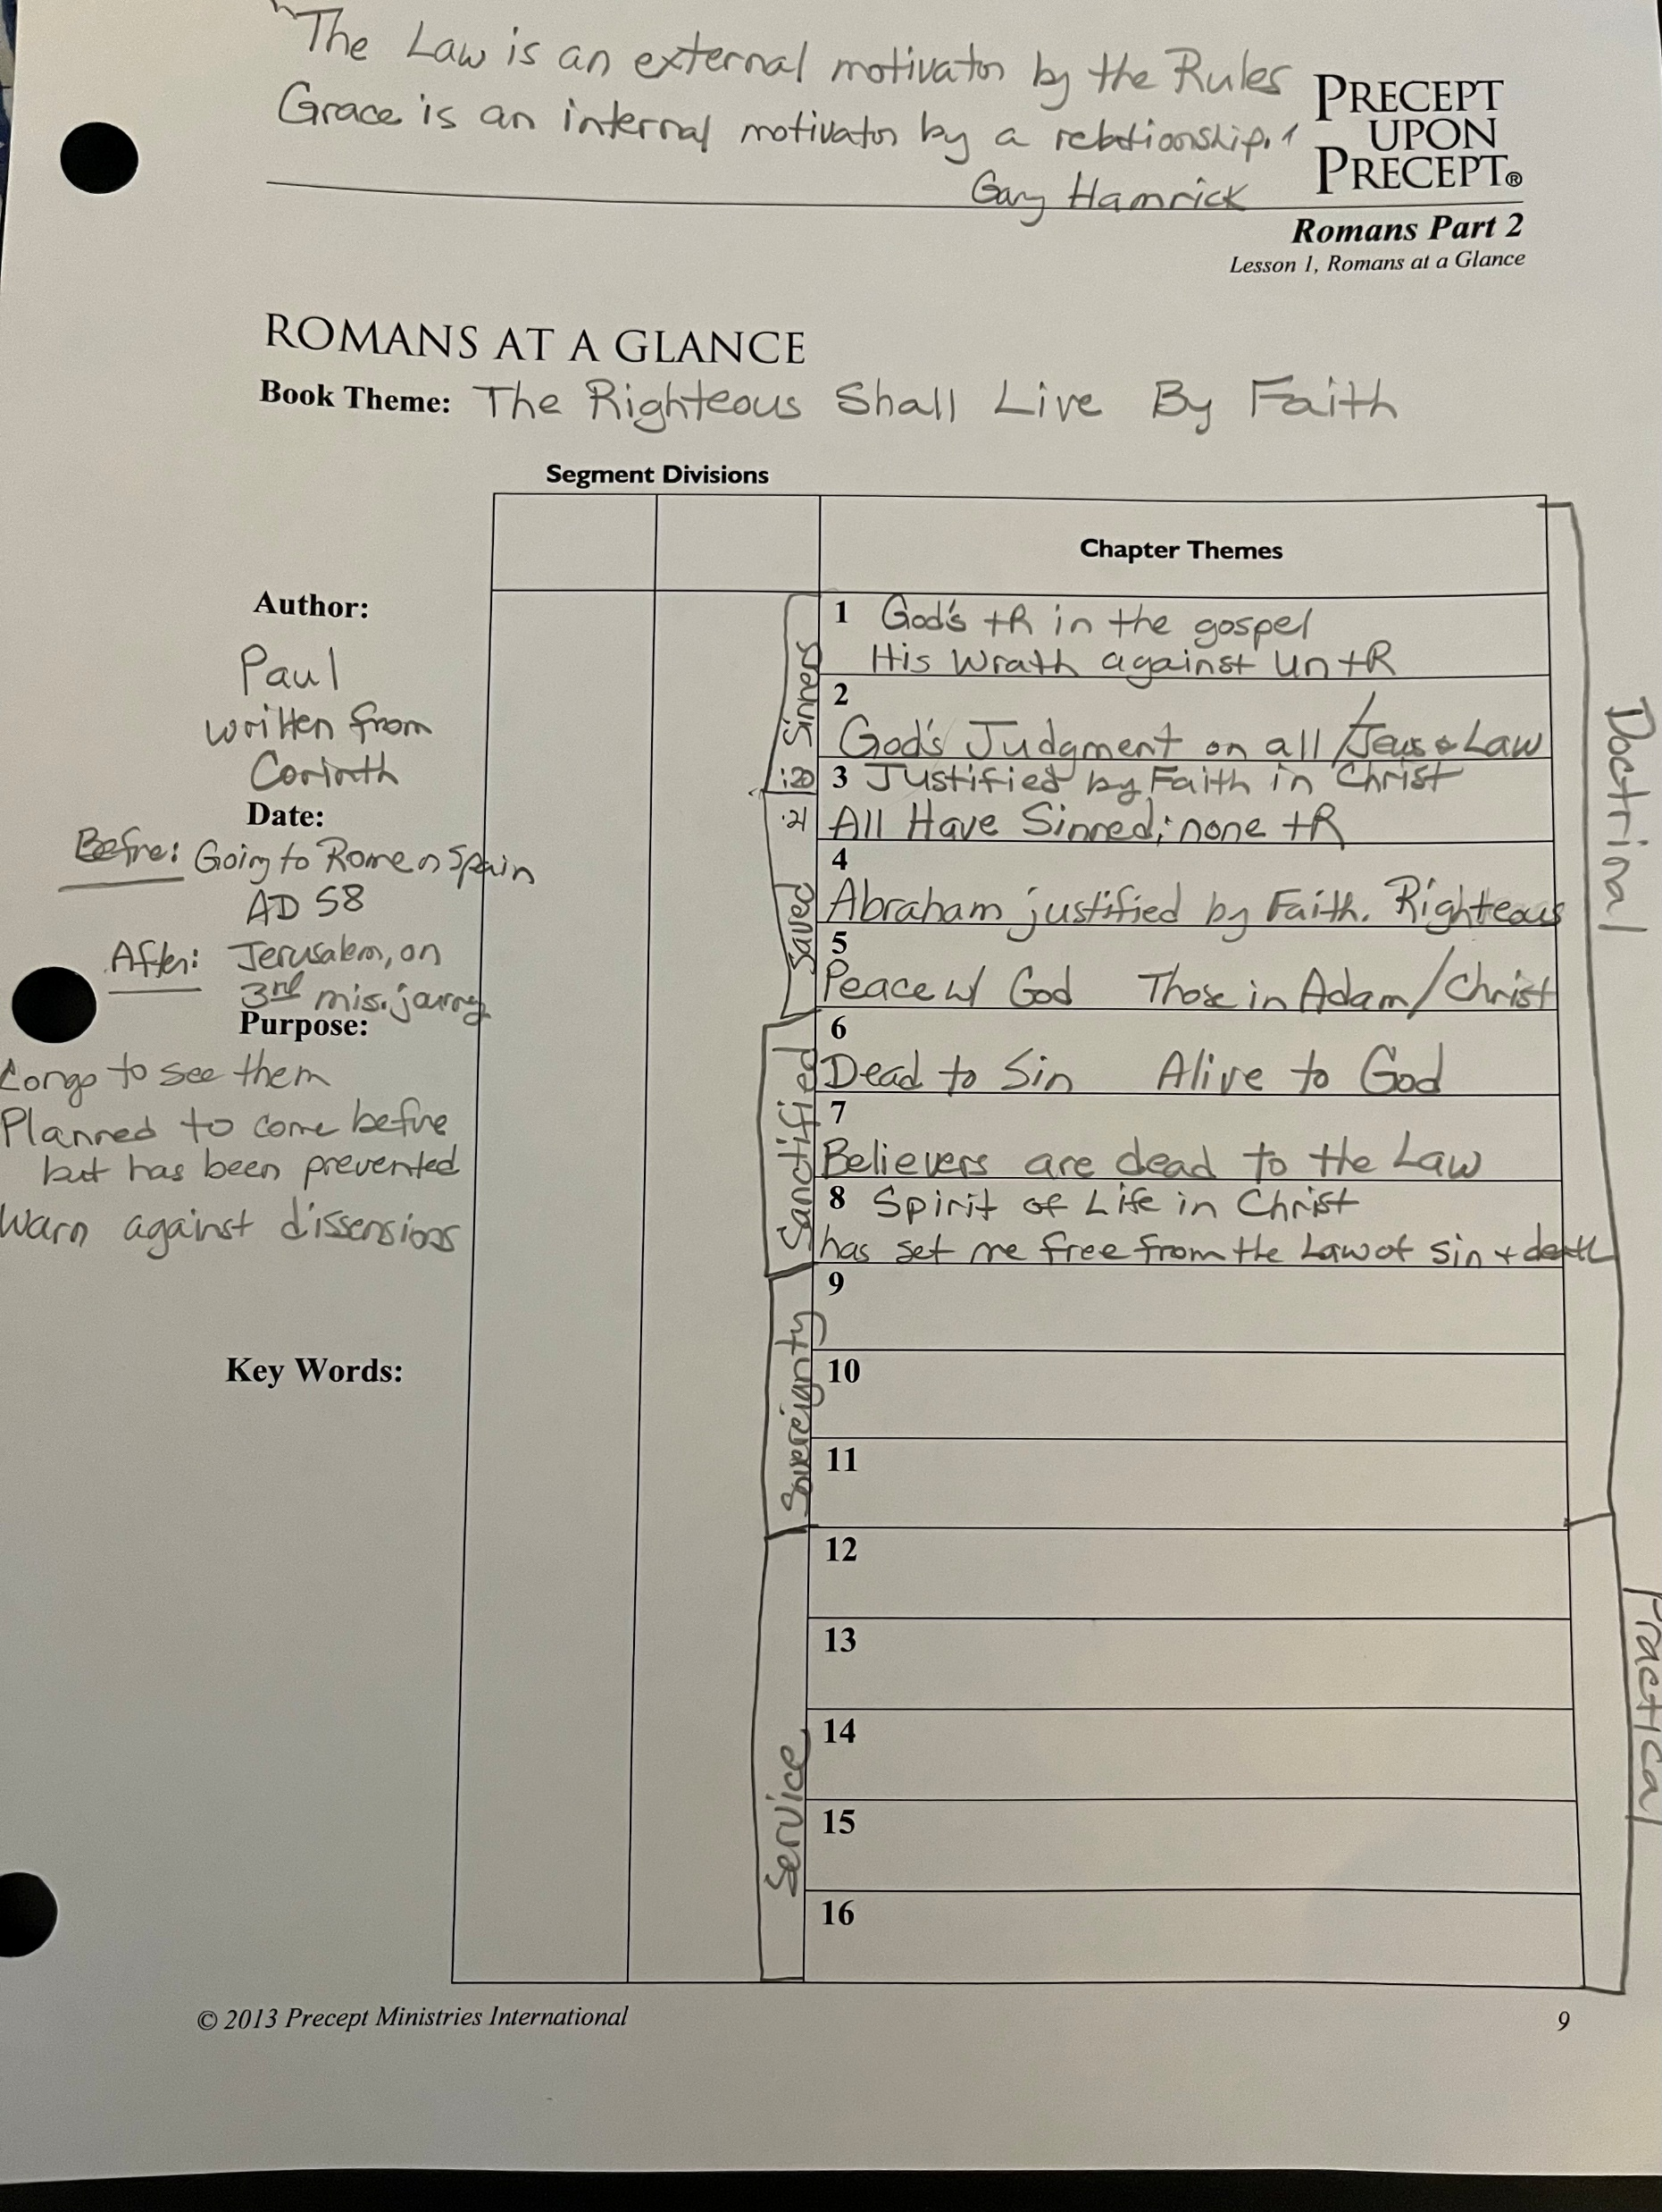
At A Glance Chart

Slide 7
Romans 5:10
We are not only saved by Christ’s death – paying the penalty for our sins – we are saved by His life.
He is able to save completely those who come to God through Him, BECAUSE, “He always lives to intercede for them”. Heb. 7:25
Why does Christ always interceding for me qualify Him to save me completely?
3842: “pantote”: signifies an unbroken consistent state or action, often used in the New Testament to describe the constancy of faith, prayer, or God’s presence. It emphasizes the idea of something being perpetual or without interruption. (Rom. 1:10 Paul constantly prays for the Romans)
Weirsbe: “He is interceding for each of us, a ministry that assures us that we are secure.” (Rom. 8:26,34) Both Spirit and Son are interceding for us

Slide 8
Application
If/Since both the Spirit and the Son are interceding for me, to the Father, should I not be supplicating for my fellow believer and the unsaved?
Prayer truly DOES change things.
As we focus on praying for our unsaved friends and family, we become more like Christ, seeking the kingdom of God first.

