Slide 1
Romans Part 2
Lesson 6

Slide 2
Review
Romans 1:1-17 The gospel and its power for salvation for all who believe
Romans 1:18-3:20 There is none righteous. All have sinned
Romans 3:21-5:21 We are justified by faith, not law
Romans 6-8 Believers are dead to sin, alive to God: Sanctified

Slide 3
Romans 7
Theme: The Believer’s Relationship to the Law/The Righteous are dead to the Law
When we interpret this chapter, this context is critical!!!
1. Is the Law sin? May it never be!!!
It is true, we died to it and are set free from it, but the Law serves a purpose. It showed me my sin and the sinfulness of it.
2. Did the Law become the cause of my death? May it never be!!!
Sin caused my death. The Law is holy, righteous and good.
The Law is spiritual, and I am flesh. Nothing good dwells in the flesh.
Notes:
!!

Slide 4
Romans 8:1-17
The law of the Spirit of life in Christ Jesus sets us free from the Law of sin and death.
The Law cannot give life, only Christ can do that.
Requirement of the Law is fulfilled in those who walk according to the Spirit
Holy Spirit lives in every believer, enabling them to be righteous
Romans 6:4 Believers were raised in Christ to walk in newness of life.
Romans 7:6 Believers died to the Law and serve in newness of the Spirit.

Slide 5
New Covenant
Jer. 31:31-34 God said He would put His law within, not on tables of stone but on the heart.
Israel would be His people, and He would be their God.
He would forgive their iniquity and remember their sins no more.
Jer. 32:38-41 He would give them one heart and one way so that they would fear Him always and not turn away from Him.
This Covenant is an everlasting covenant.
God promised to plant them in the land and not turn away from them

Slide 6
New Covenant
Ez. 36:22-27 God promised to cleanse them when He gathers, takes and brings them back from the nations, and plants them in their land.
God promised to give them a new heart and a new spirit that He would put within them, causing them to walk in His statutes.
Rom. 6:4 Newness of life
Rom. 7:6 Newness of Spirit, within, so we CAN walk in His way
Heb. 9:15-17 Jesus is the Mediator of the New Covenant
Mediator: agent of something good, a go between, role of a priest; intervenes, between God and humanity, to restore peace
The New Covenant became valid after Christ’s death

Slide 7
New Covenant
Heb. 10:1-18 The Law was a shadow, not the living form, of the goodness to come
Jesus took away the first in order to establish the second
Now, God writes His law on our hearts and remembers our sin no more.
2 Cor. 3:1-18 We are now servants of the new covenant of the Spirit
The Spirit gives life, not death.
It’s not like the Old, the Law, with a veil over the hearts of the unbelieving
The Spirit of the Lord brings freedom – liberty.

Slide 8
Understanding Romans 6-8
Romans is about salvation. It is the doctrine of our faith.
Chapters 6-8 tell the believer what his relationship to the Law and sin are.
The righteous live by faith, not by the Law. (Judaizers)
Sanctification: What is the believer’s life supposed to look like?
Died to sin so it is not my Master
I am free from sin because I died to the Law and was raised to walk in newness of life in the Spirit. (Antinomians)
Jesus is now my Master, and I am a slave to God and His righteousness.

Slide 9
I John 3 and Galatians 5
I John 3:4-10 Sin is lawlessness and Jesus came to take away sins
NO ONE who practices sin knows Him (habitual way of living)
The one who practices righteousness IS righteous
The one who practices sin IS of the devil
God’s children and the devil’s children are obvious
Romans: The Righteous shall live by faith
Gal. 5:16-21 Walk by the Spirit and you will not fulfill the desires of the flesh
The war, then, is between the flesh and the Spirit.

Slide 10
Romans 7
Is Paul speaking of the regenerate or unregenerate man?
Context: The believer’s relationship to the Law/sin/Old Covenant
Rom. 7:1-3 Marriage: the woman “died” to the marriage because the husband died, releasing her from that covenant. She is now freed from that old covenant of marriage, to marry again; be joined to another.
WE have been released from the Law because we died to it
Rom. 7:7-12 “Paul uses the illustration of coveting because it is an inward attitude, not an outward action. Covetousness leads to the breaking of the other 9 commandments.” Wiersbe
The Law didn’t cause death; sin did. The Law only revealed our sin.

Slide 11
Paul’s testimony in Acts
Paul was blameless according to the Law
Pharisee of Pharisees
His confidence was in the flesh by keeping the Law
But Christ confronted him, blinded him, and showed him how much he must suffer and endure for His name’s sake.
Christ sent Paul to the people to open their eyes so that they may turn from darkness to light and from the power of Satan to God; to repent, turn to God, doing deeds and living lives which are consistent with repentance.
Christ revealed Paul’s sin through the Law and his eyes were opened to his need of a Savior, so he feels obligated to share this great salvation

Slide 12
Philippians 3:2-16
Paul gives his heritage, his pedigree, his qualifications
Then he called them “dung”. He counted it all as loss.
Then he testifies of what he has found in Christ, NOT the Law.
His righteousness is not his own, but Christ’s
He takes pride and exults in Christ Jesus. He takes no confidence in the flesh and considers all that to be his former way of life.
NOW: he presses on toward the high calling of Christ Jesus
NOW: he forgets what lies behind and reaches forward to what lies ahead

Slide 13
Romans 7:13-25
Paul uses himself, now, as an illustration
A person practicing evil that he doesn’t want to do
A person who knows the Law
A person who needs to be set free
One who serves the law of sin with his flesh
This does NOT describe the regenerate man, but the Unregenerate man.
Verse 24-25 Wretched man: describes a person who is exhausted after battle. That’s who Paul was before his salvation
This man needs setting free! Thanks be to God who sent Jesus to save us

Slide 14
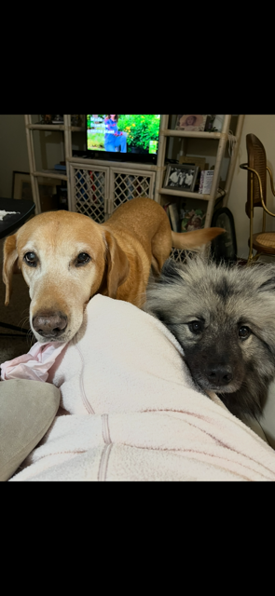
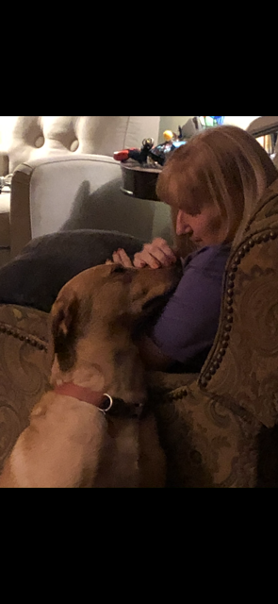
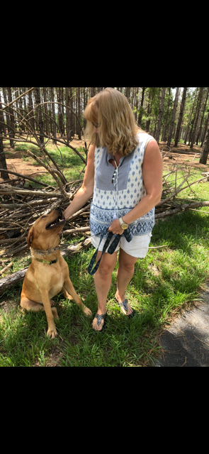
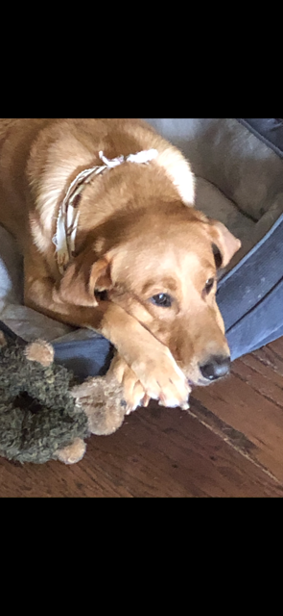
My Illustration

Slide 15
Regenerate
Jake: His story is one of rescue: rescue from starvation, neglect, abuse and abandonment.
He was 20 pounds underweight, had scars from being in a fight (which he obviously lost), dirty and lost. He knew he needed to be rescued.
Later on, we found out that he had been shot as the x-ray showed buckshot riddled throughout his spine, which doesn’t cause him pain or restrict him at all. Nevertheless, it IS inside him.
Jake was rescued, fed, sheltered, bathed, neutered and vaccinated.
Now, he needed real rescuing: someone to adopt him as their own
That was me. But Jake chose ME, before I chose him.
Jake is obedient, loving, kind, gentle…...and mine. The thought of going back to being lost, starving and abused doesn’t enter his mind. He is home.

Slide 16
Unregenerate
Gracie: She is a pure bred Kees hound. Papers even to prove it.
She is a little over two years old
She was adopted by my mother as a puppy.
She has never known neglect, abuse, abandonment or need. Only love
Yet: She has no manners. No desire to behave, but loves my mother and Jake and life itself. Her only deterrent is a spray water bottle which keeps her at bay, but does not change who she is.
She plays with Jake, shares her toys with Jake and has a great time.
When Jake leaves, her behavior does not change, nor will it. Because SHE has not changed. HER choice.

Slide 17
Application
Jake knew hardship, though he was a good dog. His manners are impeccable; something I did not teach him. He desires to please and his behavior is governed by his love of me, not his fear of punishment from me. “I am his savior”.
Gracie: never knew hardship, but is a loving dog. There is nothing there to make her obey, though her “savior” tries. She does not see her need of a savior for she has never known hardship or want. She’s a “good dog” who is taken very well care of. She will spend the rest of her life living for herself and her wants and being happy to be alive, but will never be what she could have been, had she chosen her “savior” over herself. That never happens.
So who do I chose? Living for myself, or for my Savior who set me free.

