Slide 1
Romans Part 1
Lesson 2

Slide 2
Review
The apostle Paul wrote Romans, TO the believers in Rome.
Why? To tell them he wanted to come to them, to be encouraged,to explain that salvation is by faith and to warn them about those who cause dissensions.
Theme of the WHOLE BOOK?
The Righteous Shall Live By Faith
Every chapter theme will back this up by either telling how, who or what we can do, in order to live a righteous life.

Slide 3
Segment Divisions
Romans chapter 1-11 Doctrinal part of the book
It explains salvation, justification by faith and righteousness
Romans chapter 12-16 Practical part of the book
It tells us HOW to live righteously
Romans chapter 1-11 explain the mercies of God to us
Romans chapter 12 opens with: Therefore, (because of all he said in chapters 1 -11) I urge you brethren, by the mercies of God, to present your bodies a living and holy sacrifice, acceptable to God, which is your spiritual service of worship.
Paul spoke about worship in the first part of the book, and who and what the ungodly worship, though they KNOW it is wrong.

Slide 4
Romans 1-5
Key Words: Judgment, Law, conscience, faith, righteous, unrighteous
Chapters 1-3 Righteousness comes by faith in Jesus Christ
This righteousness is IN the gospel, God will judge impartially
Romans 4 gives us an Old Testament example of Abraham being justified by faith BEFORE being given the sign of circumcision.
Romans 5 tells us the RESULTS of being justified by faith: We have peace with God, and not wrath (vs. 2,3,5,25) (1,9,16,18)
We have the free gift of eternal life through Jesus Christ

Slide 5
Romans 6-8
Key Words: Dead, sin, law, grace, baptism, slaves, alive, Law, flesh, spirit, obey, righteousness, obey
Romans 6 Dead to sin/Alive and slaves to righteousness (vs. 11,18)
Romans 7 Dead to the Law (vs. 4,6)
Romans 8 Law of Spirit of life in Christ sets me free from the law of sin and death (vs. 2)
This segment might be called: The Sanctification of the Believer
Be sure to mark: obedience of faith – continuance in the faith – sanctification

Slide 6
Romans 9-11
Chapter 9 Descendants are children of the Promise, not children of the flesh
Key Words: Israel, remnant, flesh, promise, faith, called, mercy, works, law
Paul’s sorrow and grief over his brethren, his fellow Israelites come through in this chapter
Chapter 10 Christ is the end of the Law for righteousness
Key Words: believe, know, heart, righteousness, call, hear
Paul’s desire for the Jews’ salvation
Chapter 11 Israel is NOT rejected: God has kept a remnant
Key Words: branches, root, kindness, graft, remnant, grace, works, reconciliation, reject, riches, jealous
God has not rejected His people, Israel; all will be saved. God’s Sovereignty

Slide 7
Romans 12-16 Segment
Romans 12 “Therefore”: by the mercies of God….
PRESENT your bodies, your physical bodies, holy and acceptable, for His service
How can they be “holy and acceptable”? Because our righteousness is through faith IN Christ, not by anything we have done.
12:5 We are ONE body, both Jew and Gentile, with differing gifts
Key Words: conformed, transformed, think, body, members, grace, love, serve/ service, same, evil, good
Romans 13 Love for your brothers fulfills the Law.
Be subject to authorities, who are from God.
Key Words: authority/rulers, fear, good, evil, subjection, wrath, love

Slide 8
Romans 12-16 Segment
Romans 14 Accept one another, whether weak or strong
Give thanks (1:21) Pursue those things which make for peace (14:19)
Key Words: faith, weak, eat/doesn’t eat, live/die, judge, food clean/unclean, condemn
Romans 15 Christ became a servant to the Jews on behalf of the truth and a servant to the Gentiles to glorify God.
Key Words: strong, one, hope, preach, spiritual/material, peace
Romans 16 Warning: Keep your eye on those who cause dissensions, turn away from them. Be wise in what is good and innocent in what is evil
Key Words: obedience (1:26), faith, greet

Slide 9
Segments in Romans
Romans 1:1-17 Introduction States the book theme
Romans 1:18-3:20 All have sinned, both Jews and Gentiles
Romans 3:21-5:21 All are justified by faith
Romans 6-8 Sanctification; freed from sin and the Law BY the Spirit
Romans 9-11 Jews, God’s sovereignty in choosing them
Romans 12-16 How to serve one another in the body of Christ, Jews and Gentiles: no partiality

Slide 10
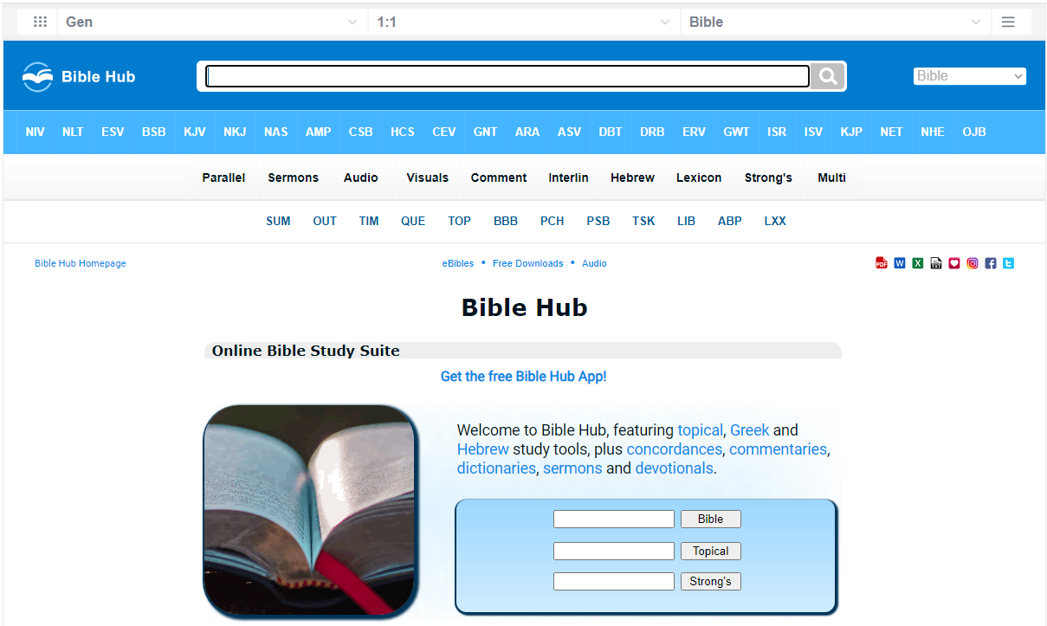
Biblecc.com or Biblehub.com

Slide 11
Biblecc.com or Biblehub.com
Click on Lexicon

Slide 12
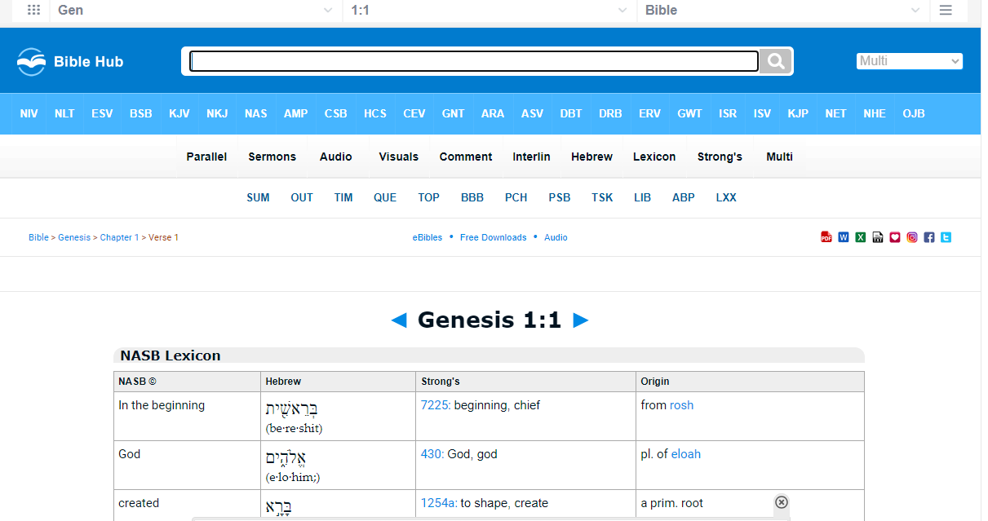
Lexicon

Slide 13
Lexicon
Click down arrow to select verse
Click down arrow to select book

Slide 14
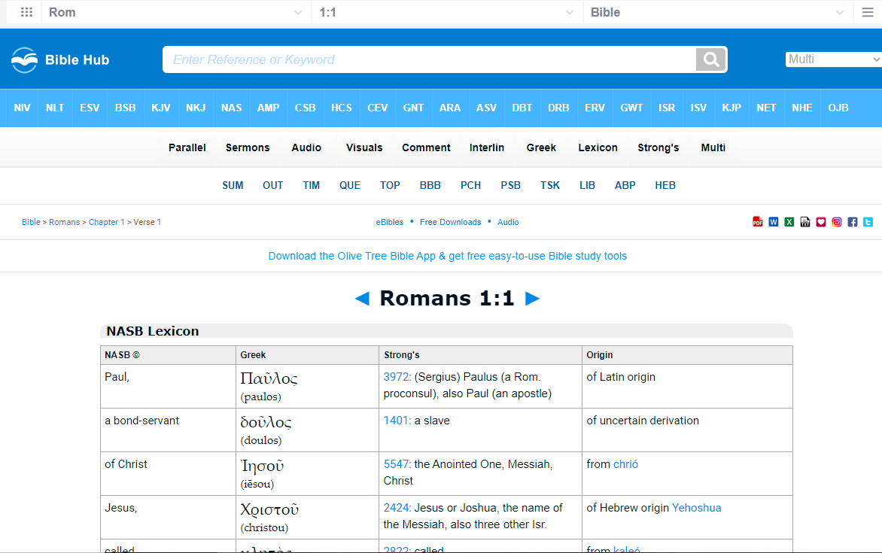
Pick word
Select Strong’s number
Select word or phrase

Slide 15
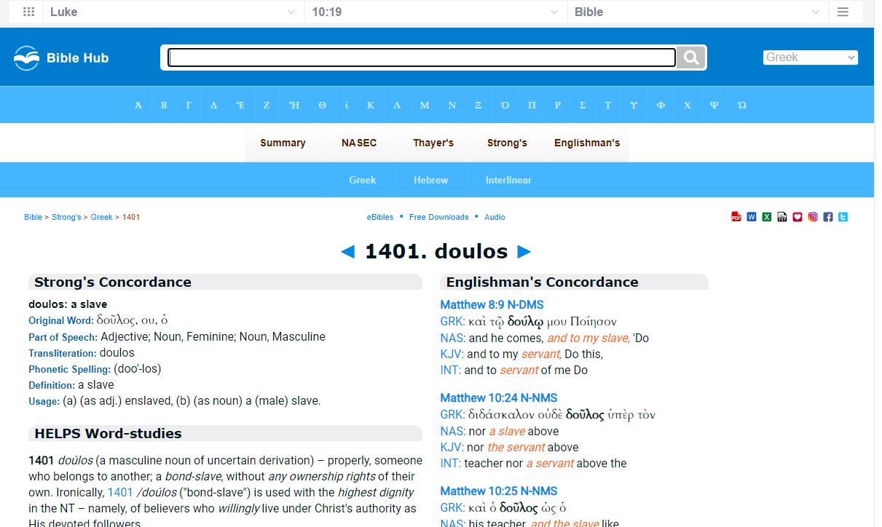
Greek Word

