Slide 1
Matthew Part 1
Lesson 5

Slide 2
Review: Another way of dividing Matthew
Matthew 1-4 Jesus is Messiah, Son of David, King
John and Jesus preach “Repent, the kingdom is at hand”
Bear fruit in keeping with repentance
Jesus proclaimed the gospel of the kingdom: Healed
Matthew 5-7 Sermon on the Mount
Righteousness required to enter the kingdom
Difference in Matthew 1-4 and 5-7:
1-4 Are events
5-7 Are teaching
Segments: 7:28 ends the first segment 8:1 -11:1 Begins another
Chapters 8-9 are events Chapter 10 is teaching

Slide 3
Matthew 8:1-4
8:1 Jesus came “down from the mountain” after preaching the Sermon on the Mount
We leave chapter 7 with the people being amazed and astonished because He taught with authority. Now we will see what He has authority over.
Healed a leper: He TOUCHED the unclean; one who had to shout, “unclean” wherever he went.
He understood Jesus’ authority; he bowed down before Him
“If you are willing”: Your will be done on earth as it is in heaven
He was to tell no one, but present himself to the priest as a witness to the PRIESTS!
Jesus came to FULFILL the Law

Slide 4
Matthew 8:5-13
Jesus goes to His hometown of Capernaum (4:13)
He agrees to heal a Gentile Centurion’s servant before he even asked: a Roman!
This Roman knew about authority and understood that Jesus had authority over things he could never have.
His faith was, “greater than anyone in Israel”. A Gentile’s faith was greater than any Jews’!
The many who “come from the east and west” are Gentiles
Matt. 7:21-23 says, “Not everyone who says to Me, Lord, Lord..”
“Sons of the kingdom” are unbelieving Jews
“Weeping and gnashing of teeth”: is a furnace of fire (13:42)

Slide 5
Matthew 8:12
“Sons of the kingdom”: earthly kingdom opposed to the kingdom of heaven
Descendants of Abraham, Isaac and Jacob
The unrepentant of Israel
Cast into utter darkness
Weeping and gnashing of teeth (22:15; 24:51; 25:30; Luke 13:28)
Matt. 3:7-10 JOHN told the Pharisees and Sadducees not to depend on being physical descendants of Abraham.
God is able to raise up children of Abraham from stones
Salvation is a PERSONAL decision, not a heritage passed down

Slide 6
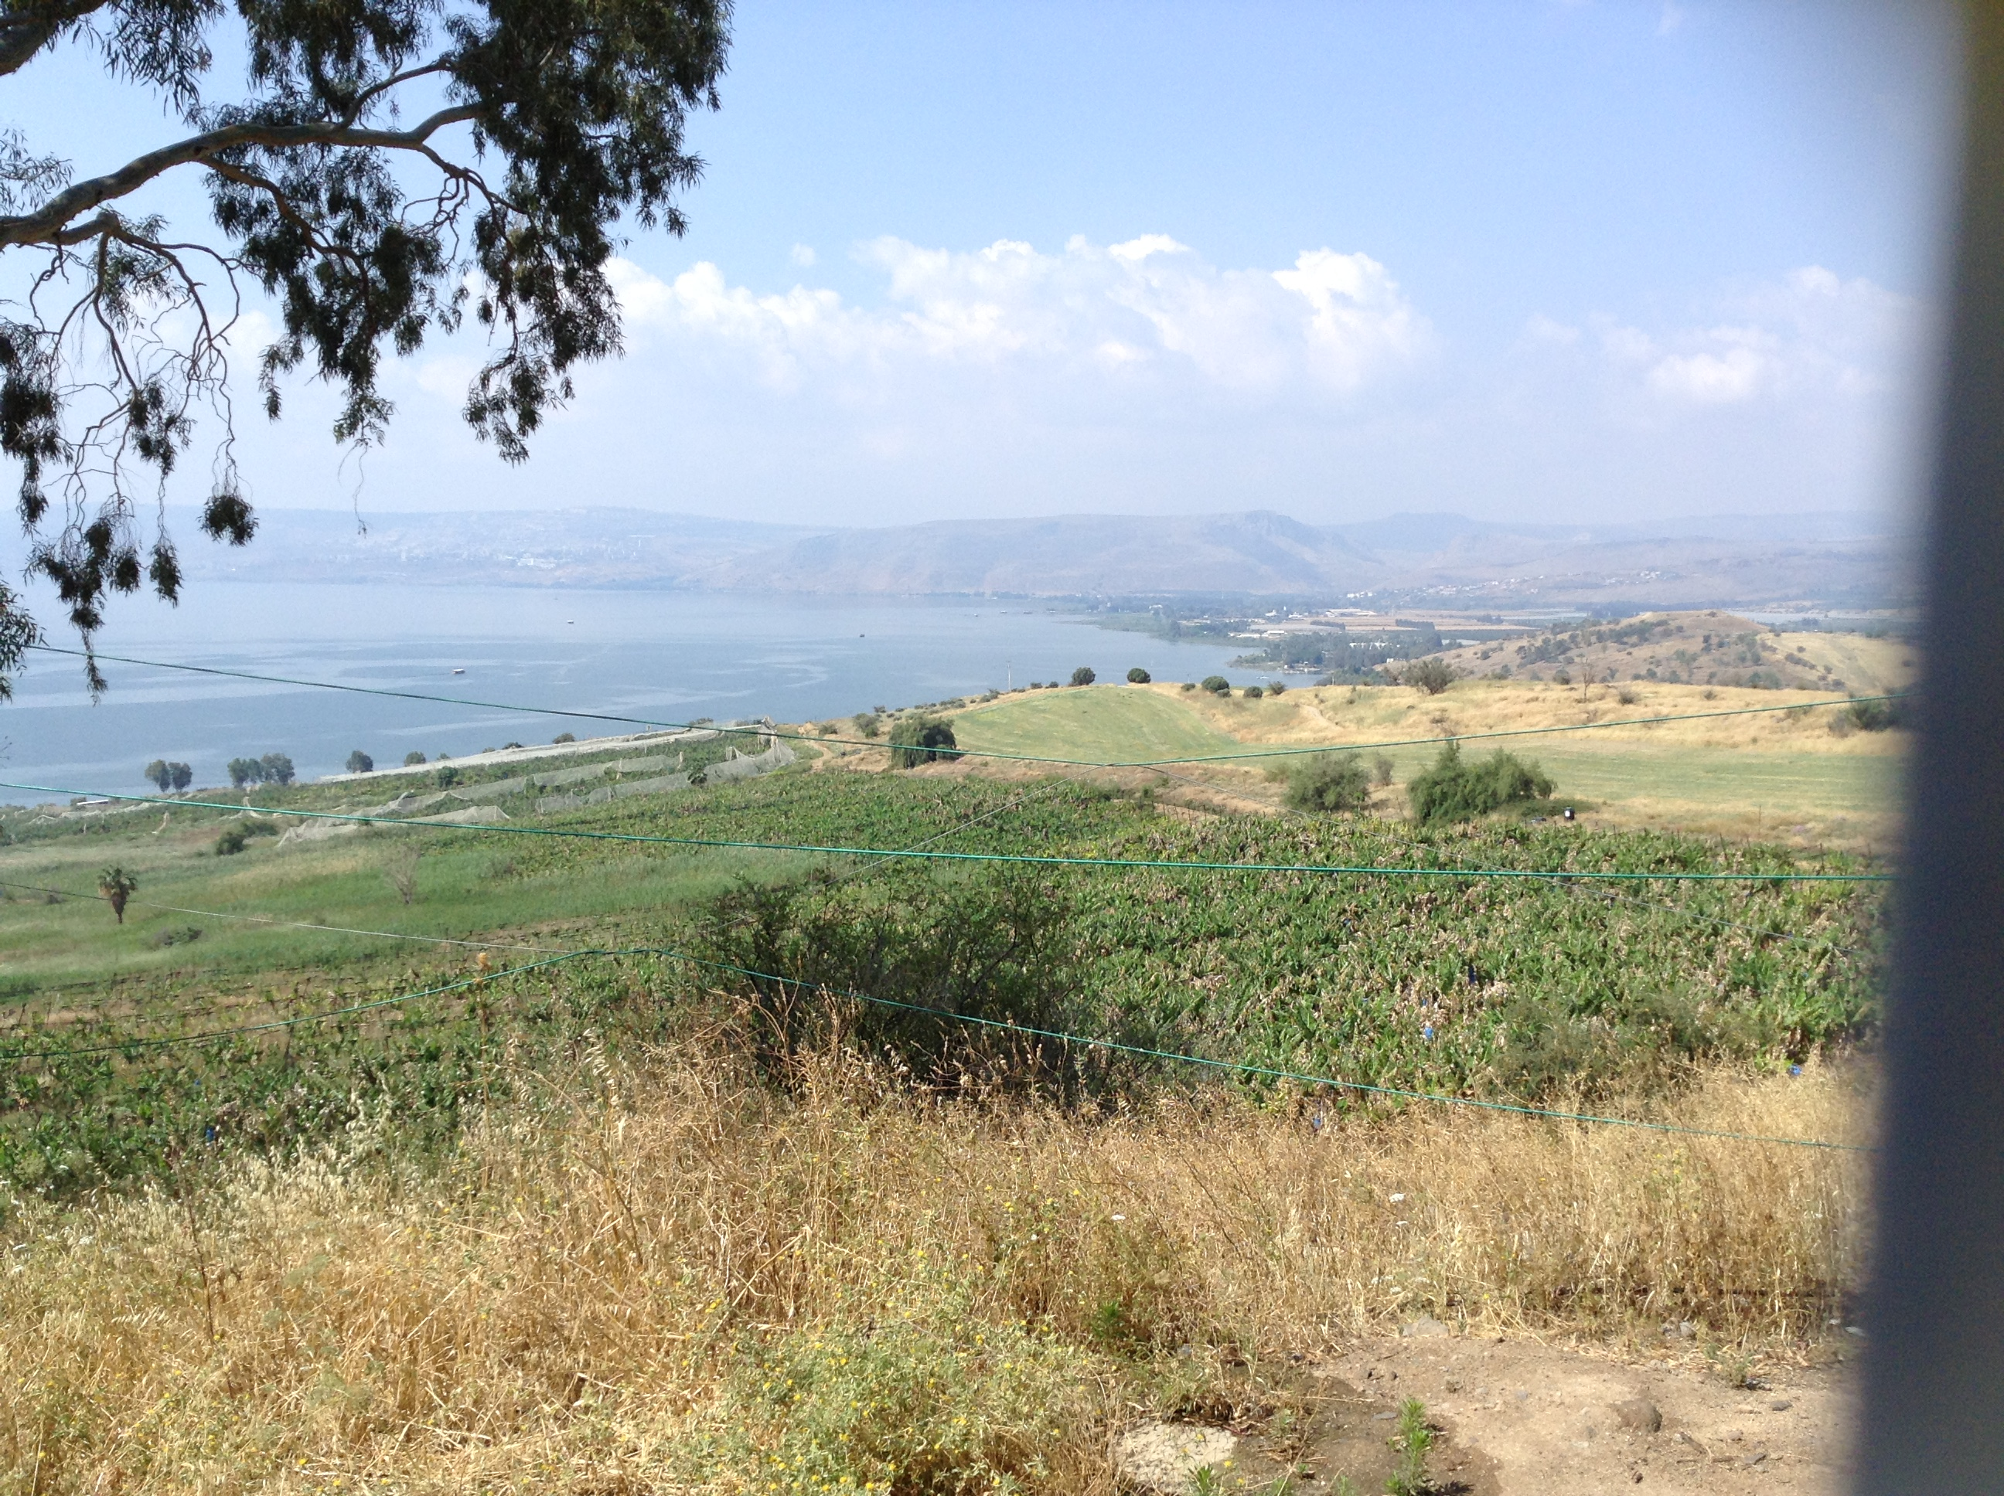
Place of Sermon on the Mount

Slide 7
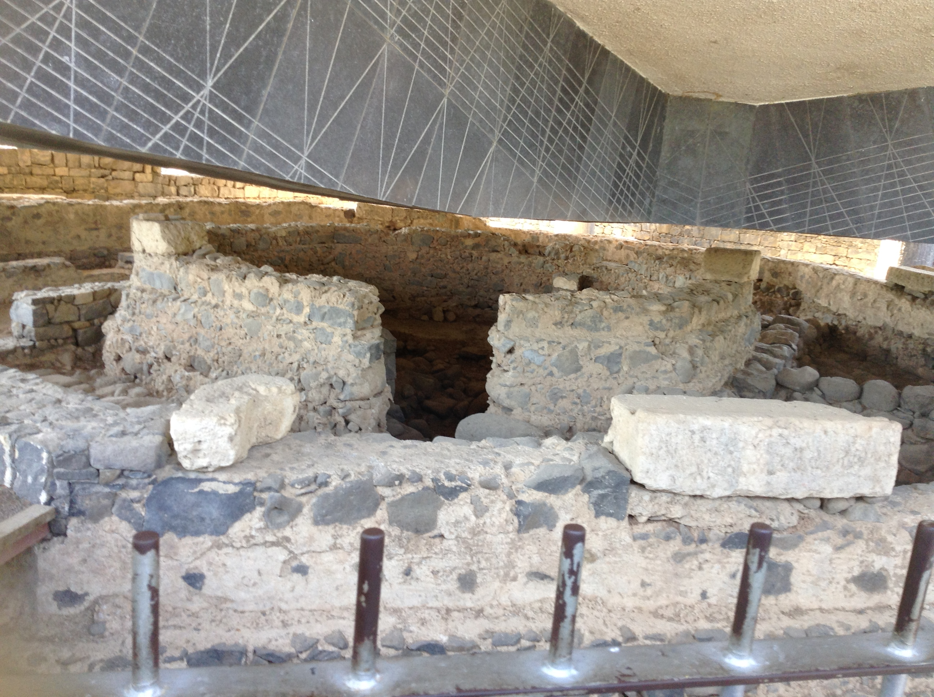
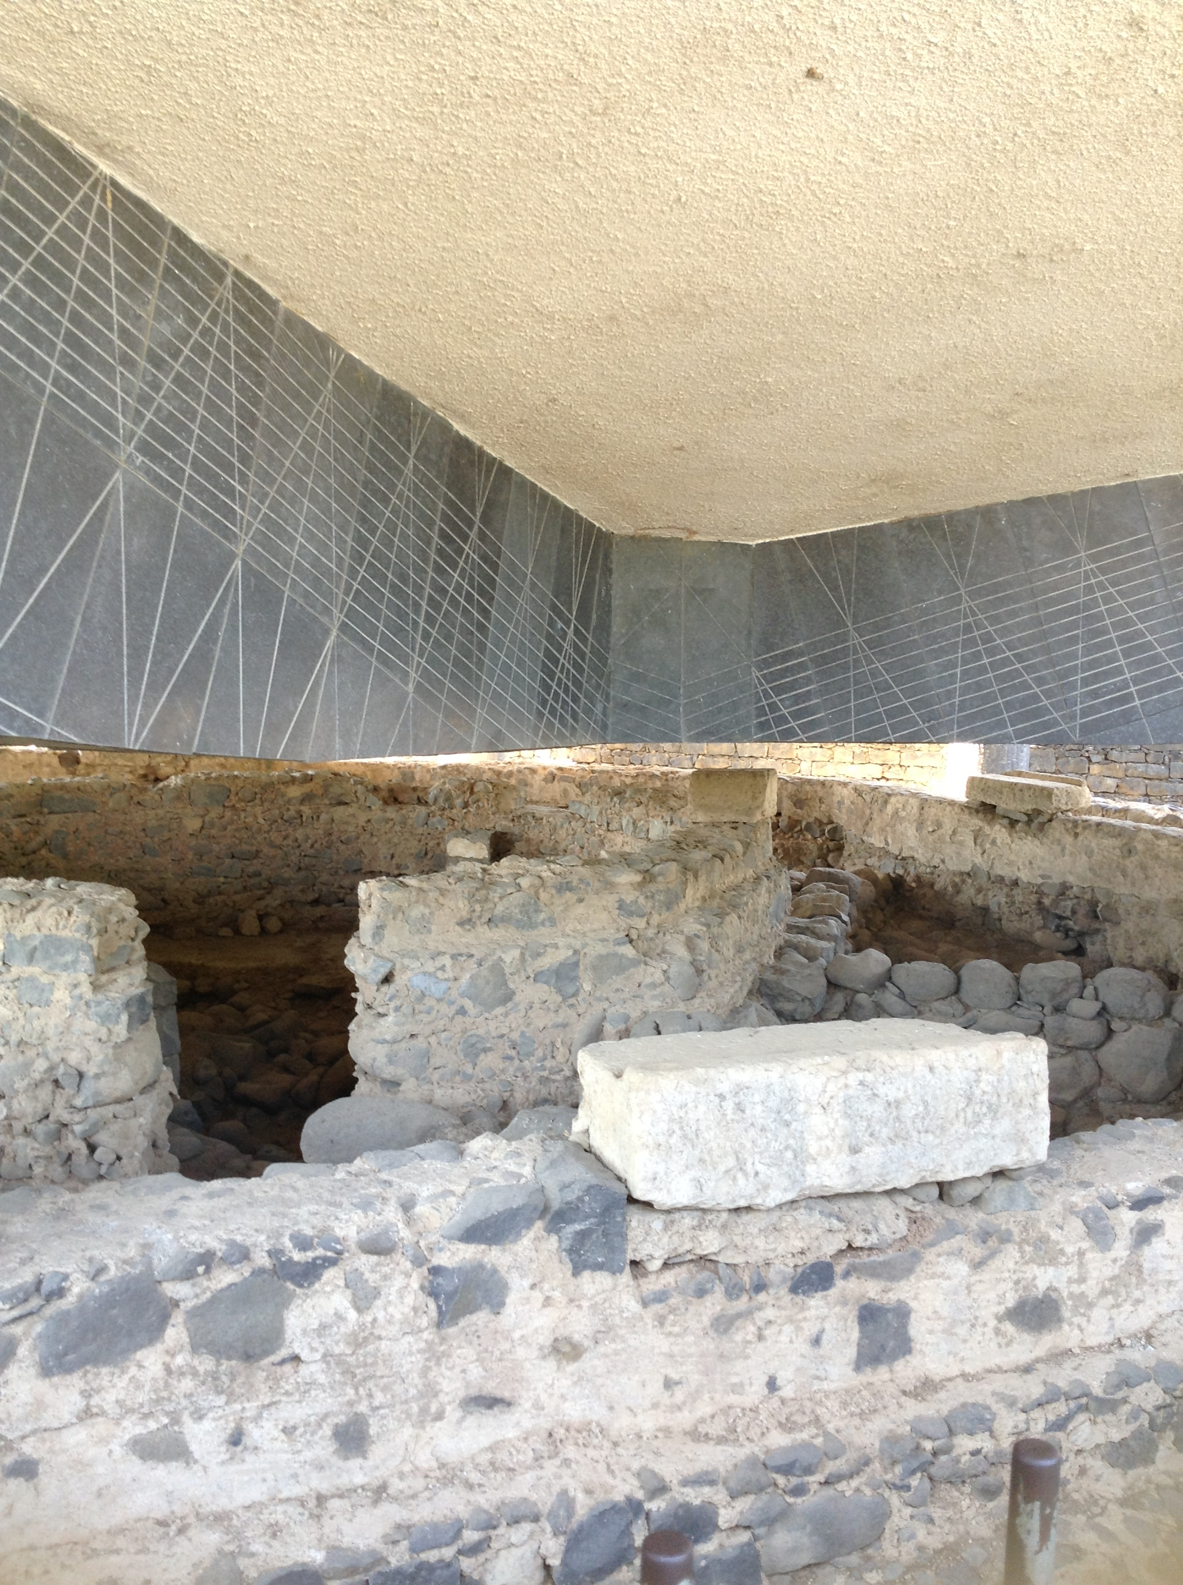
Peter’s house in Capernaum

Slide 8
Matthew 8:14-17 Events
Jesus healed Peter’s mother-in-law because He SAW her sick in bed
He TOUCHED her, making Him unclean again, yet the fever left her.
Authority over the “unseen” germ making her sick
EVERYTHING that came into this world because of sin, Jesus has power and authority to make right again.
He healed many demon-possessed, cast out spirits with a WORD, and healed ALL who were ill.
Jesus fulfilled prophecy. Is. 53:4

Slide 9
Matthew 8:18-27 Teaching
There is a cost to follow Jesus
This is the first time He refers to Himself as “The Son of Man”
He had authority to heal, but no place to lay His head
“Allow the dead to bury their own dead”: there is an urgency in following Jesus
He and His disciples get into the boat and a great storm arises.
Jesus rebukes the wind and the waves: which obey Him and immediately become calm. Can’t SEE the wind!
Authority over nature because He created it!
Now the disciples are amazed, but fearful.
“The fearful have little faith”.

Slide 10
Matthew 8:28-34 Events
Jesus crosses the Sea of Galilee to the country of the Gadarenes
Two extremely violent, demon possessed men met Him, they come to Him! “What business do we have with each other, Son of God?”
They knew He had authority over them because they asked Him to cast them into the swine. (they knew they were going to be cast out)
People’s reaction: Fear. “Please leave”
Jesus had authority over:
Demons
All diseases
Winds and Sea

Slide 11
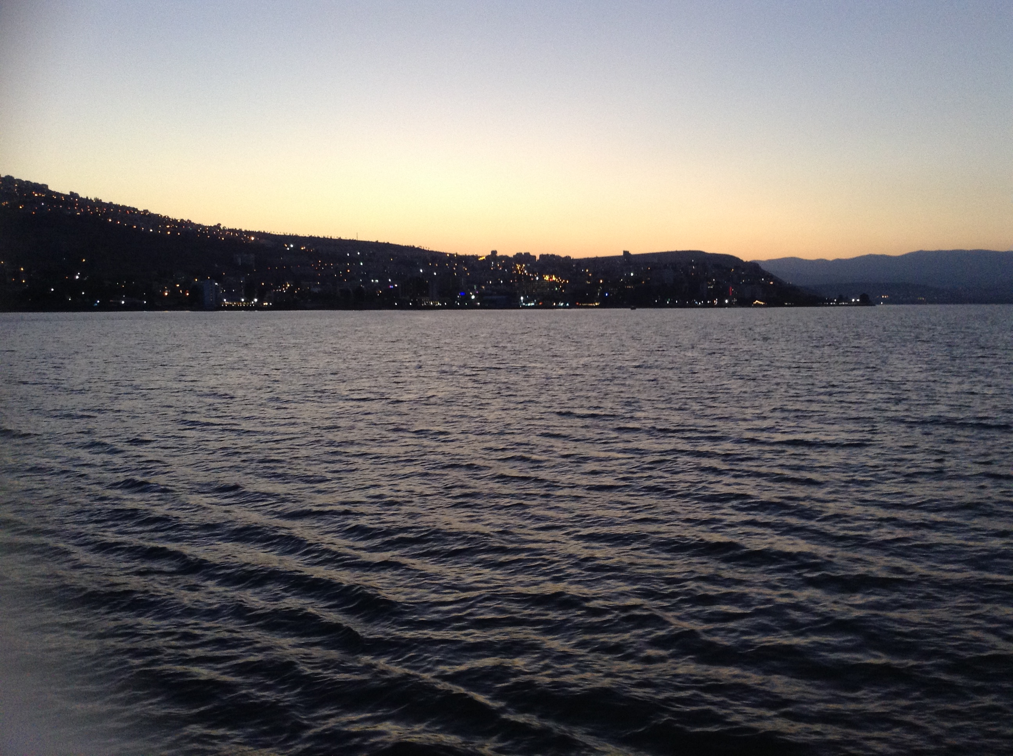
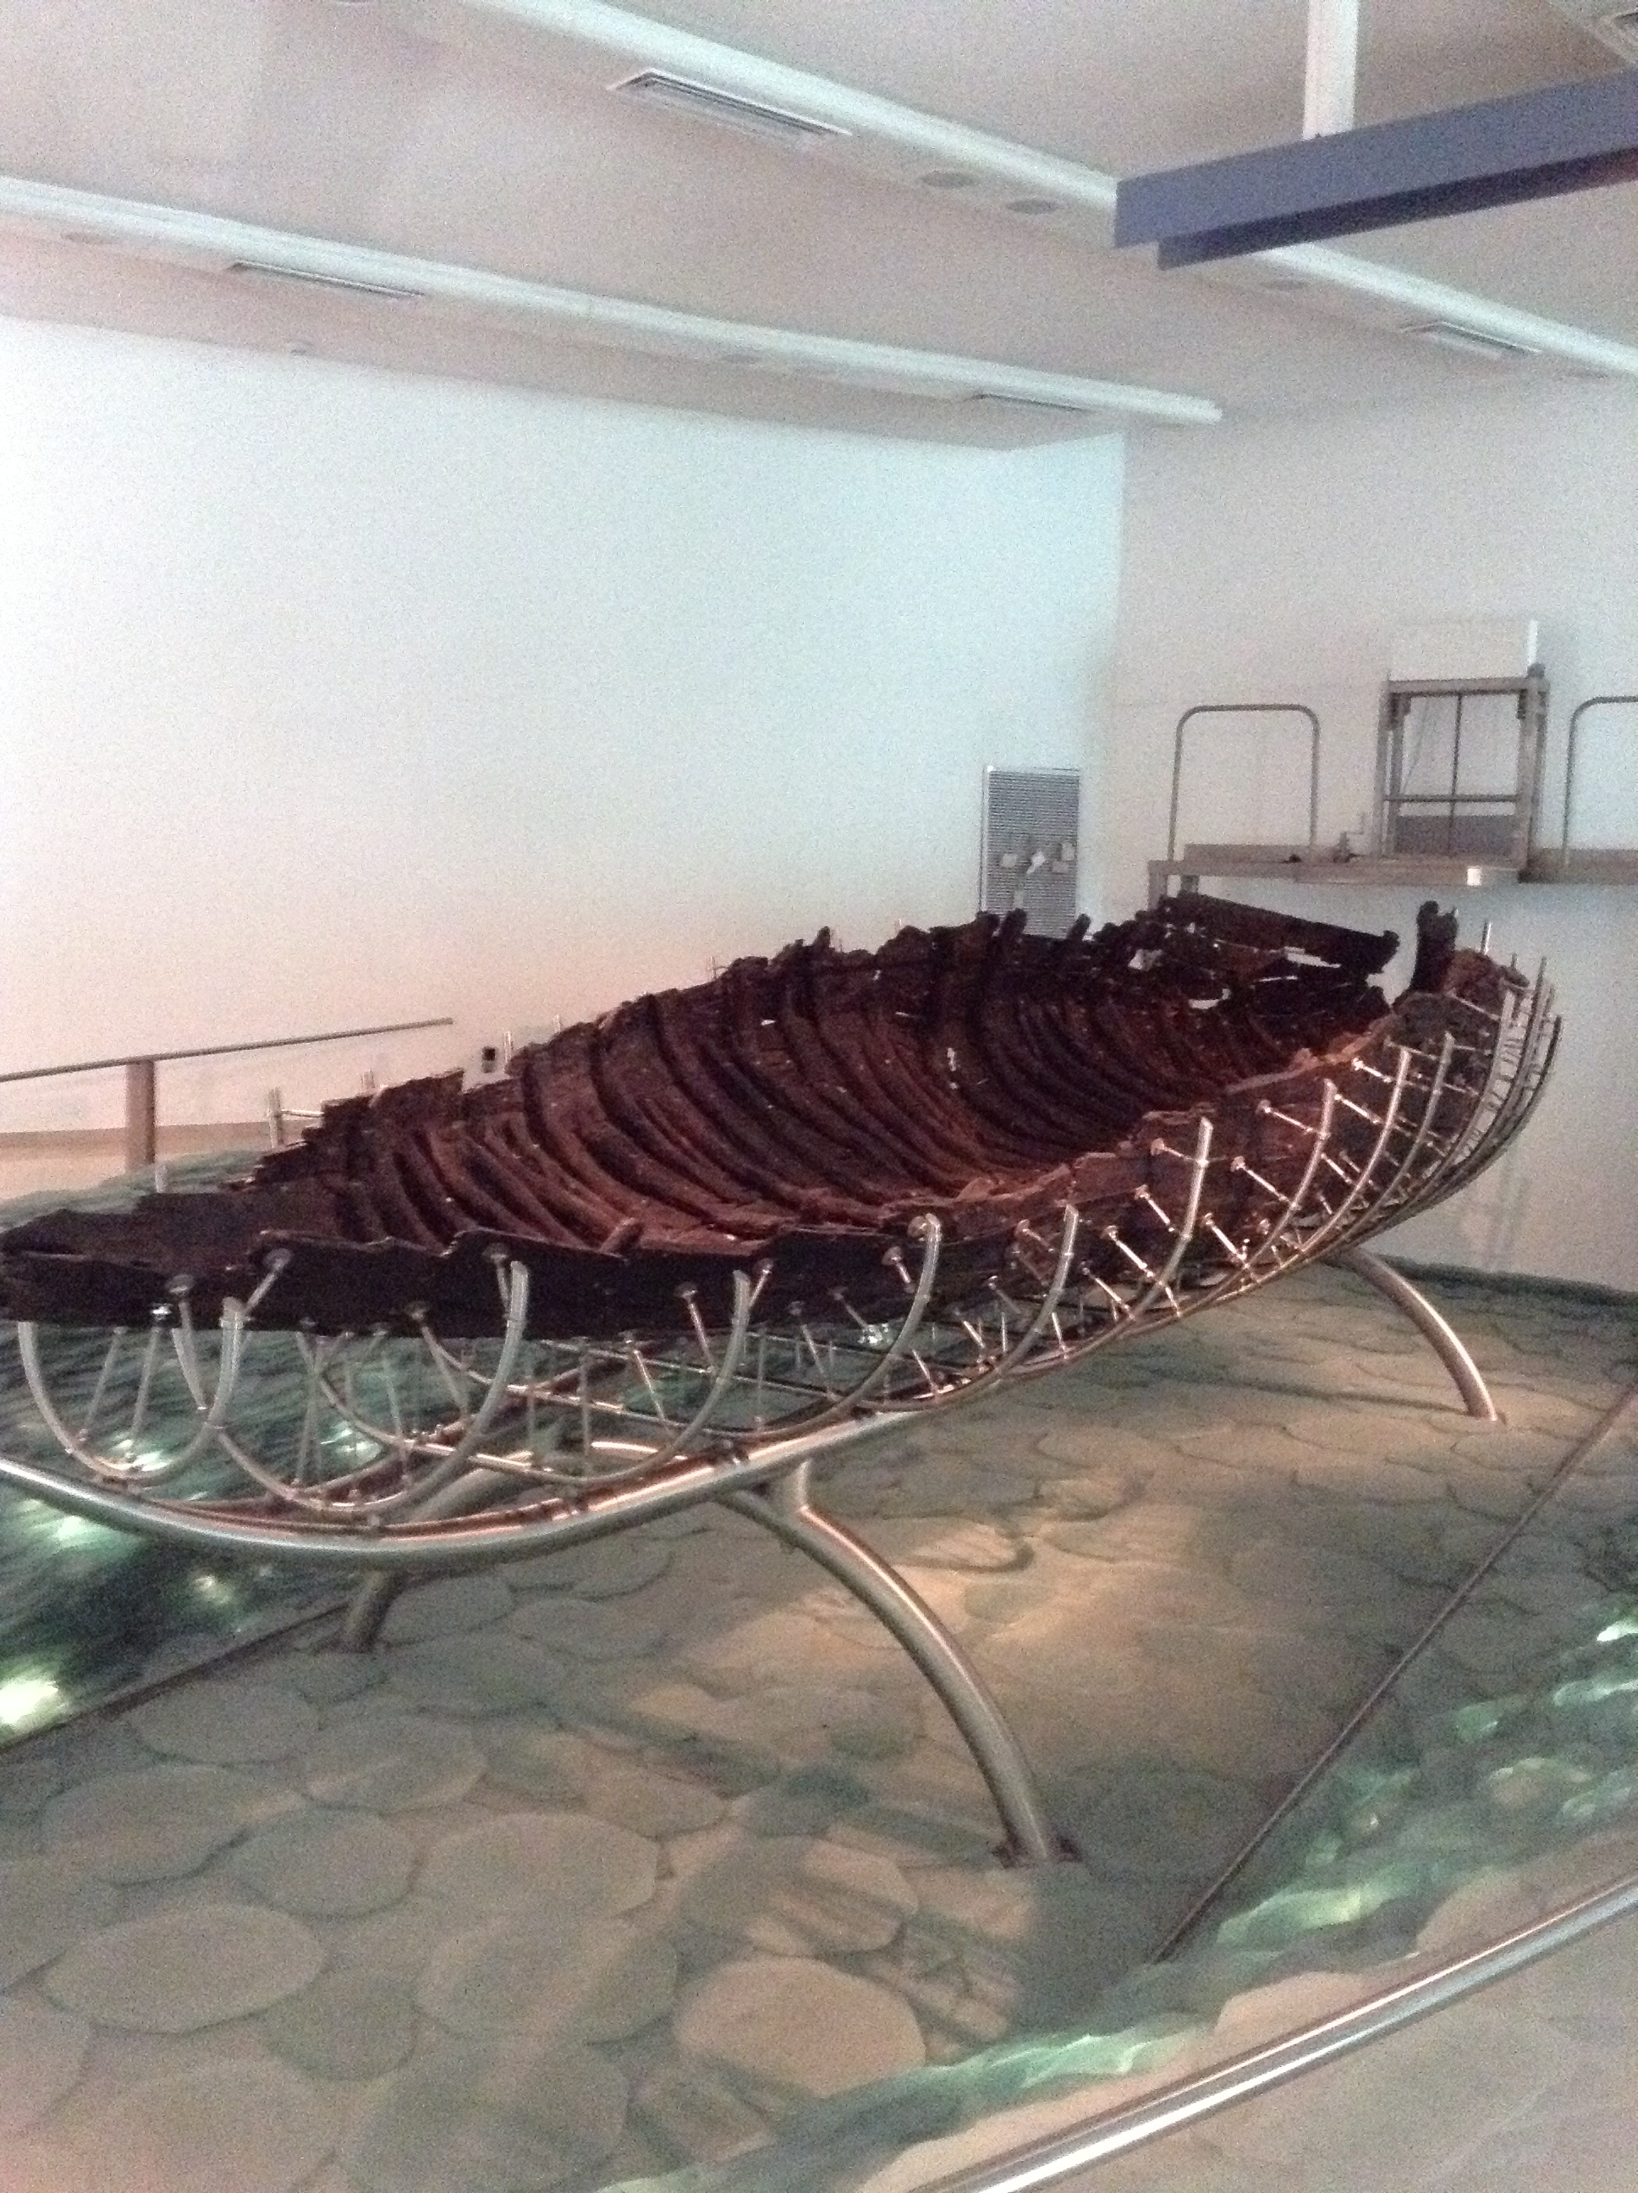
Sea of Galilee Jesus Boat

Slide 12
Matthew 9:1-9 Events
He goes back over the Sea of Galilee to Capernaum, His own city
Heals the paralytic of his sins and his illness
Why not go present himself to the priests? No offering to be made. His sins are forgiven!
Authority to forgive sins!
Jesus is omniscient because He knows the scribes’ thoughts
The people were awestruck and gave glory to GOD! (5:16)
They knew authority like this could only come from God.
Jesus calls Matthew to Follow Him

Slide 13
Matthew 9:10-13
Jesus ate with tax collectors and sinners, probably in Matthew’s house
John 12:32 Jesus draws all men unto Himself
Pharisees ask Jesus’ disciples why He does this, but Jesus answers
The sick need the physician, not the healthy.
“Go and learn what this means: I desire compassion, and not sacrifice, for I did not come to call the righteous but the sinners.”
Hosea 6:6 For I delight in loyalty rather than sacrifice, and in the knowledge of God rather than burnt offerings.

Slide 14
Matthew 9:14- 17
John’s disciples, not the scribes and Pharisees, ask Jesus about fasting
Jesus is compared to the bridegroom: He foretells His departure
Jesus gives two examples of the Old and the New; the relationship between John’s ministry and His.
John marked the end of the Old, living under the Law; Jesus brought in the New.
Don’t try to make the New conform to the Old. Don’t expect Jesus to do as John did.
Jesus came to fulfill the Law 5:17
Matt. 9:17 “Both are preserved” The Law is fulfilled, and the New Covenant is ushered in BECAUSE the Law is fulfilled.

Slide 15
Matthew 9:18-26 Events
A synagogue official, a Jew, came and bowed down to “the One who has authority” and asks Him to raise his daughter from the dead.
So, Jesus begins to follow the official to his house
AS HE IS GOING, the woman with the hemorrhage for 12 years, touches His garment, believing this alone would heal her. And it did!
Jesus calls her “daughter”!! Not UNCLEAN!!! CONDEMNED!!!
Her faith made her well. Faith in His authority and who He was.
Jesus took the dead girl’s hand and raised her from the dead!
Crowd isn’t laughing now
News spread throughout Capernaum
Jesus has authority over forgiveness of sins and death.

Slide 16
Matthew 9:27-38 Events
Two blind men followed Him asking Him, the Son of David, to have mercy on them. MERCY!!! (to spare, pity, console)
They follow Him into the house! And He heals them
Authority over the unseen cause of this blindness
They went out and spread the news, though He told them not to
People are going to notice two blind guys, who AREN’T blind now!
Mute, demon-possessed man was BROUGHT to Jesus and He cast the demon out (that had made this man mute)
This man spoke! And the people were once again amazed
But: the Pharisees said He cast out demons by the power of Satan
He has compassion: healing and teaching the gospel of the kingdom
The harvest is plentiful, but the workers are few.

Slide 17
Matthew 10:1-15 Events
Jesus sends the 12 disciples/apostles, the workers, out into the field
Jesus gives THEM authority to cast out unclean spirits and to heal EVERY kind of sickness and disease: but not forgiveness of sins
The apostles are named, and Matthew still calls himself a tax collector
They are only to go to the lost sheep of Israel; NOT the Gentiles
Don’t take any provisions for yourself. There will be worthy people that will house you…..and those that will not.
Shake the dust off your feet of those cities and people that will not receive you. Sodom and Gomorrah will be more tolerable in the Day of Judgment than these.
Why?

Slide 18
Matthew 10:16-31 Teaching
When “they” hand you over to the courts, whenever “they” persecute you, “they” malign, do not fear “them”.
Who is “they”? Vs. 16-17 Men, wolves, false prophets, Jews
10:25 They have called the head of the household, Beelzebub. In 9:34 the Pharisees said He cast out demons by the ruler of the demons.
You will be hated by all; family included. It costs to follow Christ
The one who endures to the end, will be saved. Vs. 22
Do not fear: those who malign, those who kill the body
DO: be shrewd and innocent. Beware! Fear Him who is able to destroy both body and soul in hell (Satan doesn’t even have control over hell)
You are MORE valuable than sparrows 6:21-34

Slide 19
Matthew 10:32-42
Confess Him before men: Holy Spirit will give you the words (vs. 20)
Deny Him before men, He will deny you before the Father in heaven
These are the “worthy” of Jesus. Those who receive Jesus (vs. 40)
Those not worthy: Those who deny Him and don’t love Him MORE than Father, Mother, son, daughter, brother or sister. Those who do not take up their cross (daily Luke 9:23) and follow Him.
Jesus did not come to bring peace, but a sword
Luke 2:14 “Glory to God in the highest, and on earth peace among men with whom He is pleased.”
The reward of a prophet, righteous man and disciple was the kingdom of heaven (5:6, 10) and our Father SEES in secret and also rewards in secret. (6:1-18)

Slide 20
Application
May we see people that are lost as lost sheep and have compassion on them, not judgment and condemnation.
What has following Jesus cost me this week?
DO I take up my cross DAILY and follow Him? Denying myself, my agenda, and ask for His will on earth as it is in heaven.
May I lose my life for Him so that I find it.

