Slide 1
I Peter
Lesson 5

Slide 2
Review
Recipients:
Reside as aliens
Chosen by God
Sanctified by the Holy Spirit
Sprinkled with Christ’s blood
Chosen to obey
Protected by God’s power
Where ARE Pontus, Galatia, Cappadocia, Asia, and Bithynia?

Slide 3
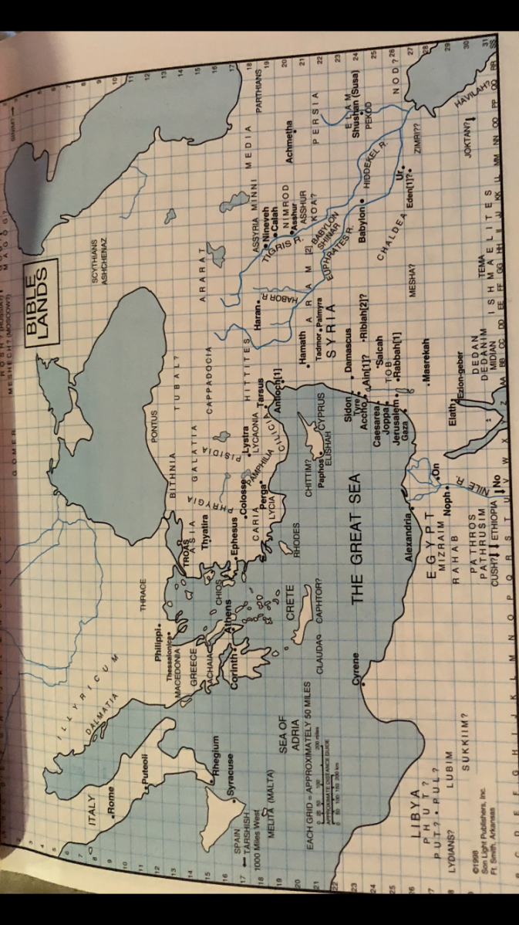
Map

Slide 4
Prepare your minds for action
“Gird the loins of your mind”
I Kings 18 Elijah’s mind was prepared for action before his body was
I Kings 18:45 Elijah outran Ahab who RODE to Jezreel! The hand of the Lord was on him vs. 46
Jeremiah 1:5-6 Jeremiah’s thoughts were on himself, but God used him to speak to Israel
Job 38:3; 40:7 “Gird up your loins like a man; I will ask YOU, and YOU instruct ME!!!”
Eph. 6 Christians prepare their minds with the truth of God’s Word for spiritual warfare
I Pet.1 Christians’ minds prepared for proper action

Slide 5
Our Minds
Rom. 12:2 Minds are renewed in the Word of God and recognize false teaching
Opposite: Conformed to the world; not transformed
Heb. 5 Accustomed to the Word of God: Meat
Opposite: Dull of hearing and immature
Heb. 6 Inherit the promises by being imitators of those who through faith and patience realize the full assurance of hope until the end
Opposite: Sluggish, instead of assured
Phil 4 Peaceful, and think on right things
Opposite: Anxious instead of peaceful, doesn’t pray about everything, not thankful

Slide 6
Prepare Your Minds: How?
Phil. 4:8 Think on things that are true, honorable….
Rom. 12:2 Regular intake of the Word of God renews your mind by putting God’s thoughts into our minds, rather than the world’s: eternal perspective
Knowing and doing God’s will is a result of that “mind renewal”
Heb. 5:4 PRACTICE training your senses to discern good and evil; eat solid food = maturity, peace and security
2 Cor. 10:5 Take every thought captive

Slide 7
“Captive”
Aichmalotizo: subdue, ensnare, bring under control, bring into subjection.
Only used 4 times in Scripture.
2 Tim. 3:6 …weak women weighed down with sins, lead on by various impulses are captivated by wicked men
Luke 21:24 Desolation of Jerusalem. Israel is led captive into all nations
Rom. 7:23 But I see a different law in the members of my body, waging war against the law of my mind making me a prisoner of the law of sin which is in my members

Slide 8
Keep Sober in Spirit
Nepho: properly, to be sober (not drunk), not intoxicated, free from illusion, free from the intoxicating influences of sin. Having presence of mind (clear judgment), enabling someone to be temperate (self-controlled); to have one’s wits about them which is the opposite of being irrational.
John 14:1-3 Let not your heart be troubled. I go..
Acts 1:9-11; Heb. 9:28; Matt. 24; Rev. 22
Be sober: remember this life is temporary. Fix your eyes on Jesus who WILL return and His reward is with Him for those who diligently seek Him. His reward is eternal and will not perish.

Slide 9
Fix your hope completely…..
Hope: elpizo – expect, trust, actively waiting for God’s fulfillment about the faith He has in birthed through the power of His love.
Zod: To hope in someone. Spoken of those who put their trust in God. To wait, expect, anticipate
Ant. To be utterly without a way, to despair, to be spiritless, dismayed
2 Cor. 4 We do not lose heart. We look NOT at the things which are seen for they are temporal. We look at the things which are UNSEEN, for they are eternal. We desire the life of Jesus to be manifest in our body while we dwell on this earth.

Slide 10
Do not be conformed to the former lusts….
I Peter Their former lusts were the things they did before their salvation, things other Gentiles were doing and they were slandered for NOT doing
Passions of the flesh/fleshly lusts
Things that war against the soul
Sensuality, drunkenness, abominable behavior….
“Conformed”- suschematizo: having outward shape, conform to; assuming a similar outward form by following the same pattern to conform oneself (mind, character) to another’s pattern.

Slide 11
How?
Gird your minds for action!
Keep sober in spirit!
Fix your hope completely on the grace to be brought to you at the revelation of Jesus Christ
If you do those things, you WON’T be conformed to your former lusts
Col. 3:5-8
Consider……
Put aside…..
This is all part of the sanctification process, the present tense of salvation.

Slide 12
Be holy because God is holy
“The fearless professor is defenseless, and Satan takes him captive at his will; the desponding professor has no heart to avail himself of his advantages, and is easily brought to surrender.” Matt. Henry
Fearless and desponding have not been transformed
Holiness and sanctification are opposite of being conformed to this world
TRIALS help to transform us and make us mature

Slide 13
Conduct yourselves in fear…
I Pet. 1:17 If a person calls God his Father, then he should act like his Father acts!!!
2 Cor. 5:10; Rom. 14; 2 Tim. 4 We will be judged by God for how we lived while here on earth.
I Pet. 1:19 Christ’s blood bought my redemption!!!
Heb. 2:14 Jesus rendered Satan powerless by redeeming me
Heb. 10:4-5 Forgiveness of sin is only because of the cross; not because of the blood of bulls or goats
Christians can’t continue to live in sin because they have been redeemed from it!
Our faith and hope can rest in nothing less than Jesus’ blood and righteousness.

