Slide 1
Covenant
Lesson 6

Slide 2
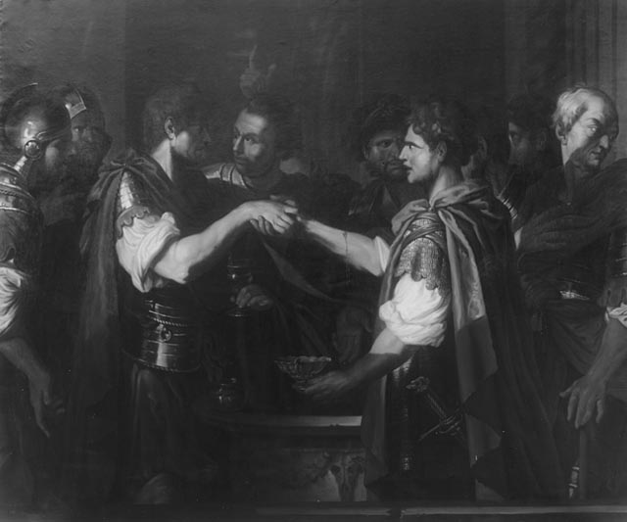
Sharing Blood-Two Become One
Showed their lives were joined
Symbolic of one soul in two bodies
Blood was shared by a cut somewhere in their body
Blood was comingled

Slide 3
“Striking Hands” Lit. “drive a nail”
Psalm 22:16 Prophetic psalm telling us what would happen to Christ: His hands and feet pierced
Psalm 22:31 They will proclaim His righteousness to a people yet unborn – for He has done it.
John 20:24-27 Jesus had scars in His resurrected body
Zechariah 12:10 His piercing was done by the ones with whom God had made a covenant.
Marks of Covenant:
Galatians 6:17 Suffering
I Corinthians 6:19-20 We are to glorify God in our bodies

Slide 4
How is a person One with Christ?
His Covenant cut made it possible for us as believers to: Become One with Him
Receive His Life
Become One Nature with Him
John 17:21-23 Christ’s prayer was that we would be one just as He and the Father were One
Why? That the world would know that He was from the Father.
Colossians 1:27 This oneness is only possible because the Holy Spirit indwells us
Ephesians 5:25-32 This is the spiritual relationship of Christ and the church

Slide 5
Sharing Possessions and Names
2 Corinthians 8:9 Speaks of spiritual riches NOT material wealth
Romans 8:15-17 Suffering with Christ
2 Corinthians 8:1-4, 13-15 Christians are to help meet the needs of Covenant partners
Genesis 17 Abram changed to Abraham
Sarai changed to Sarah
Revelation 2:17 The name that identifies me is now Christian – Little Christ

Slide 6
Sharing Friendship
2 Chronicles 20:7 Jehoshaphat called on the Lord to remember His covenant with Abraham
Isaiah 41:8 Abraham is called the friend of God
Ps. 25:14 God makes His secrets known to those in Covenant with Him
Genesis 18:17 God told Abraham what He was going to do to Sodom and Gomorrah and why
John 15:13-15 His friends do what He commanded
Part of being His friend is knowing what the Father told Him

Slide 7
Sharing a Memorial
Genesis 21:22-34 Abraham and Abimelech
Genesis 31:43-54 Jacob and Laban
Exodus 13:11-16 Sign of the firstborn
Deuteronomy 6:4 His words were to be on their hearts, teaching their children as they lie down, as they rise up and as they walk. Jews have phylacteries
I Corinthians 11:23-26 The Lord’s Supper

Slide 8
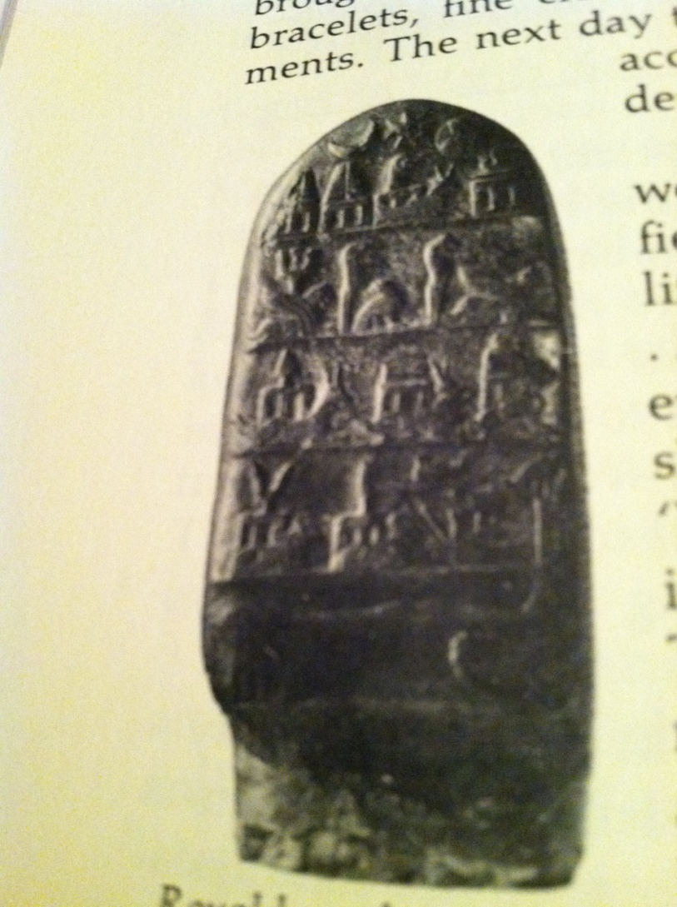
Memorials

